Slide 1
The 4 R’s You Can Make a Difference!
Teacher notes for each slide are on slides 21-24.
Notes:
Teacher notes for each slide are on slides 21-24.

Slide 2


The 4 R’s
Rethink - it's not enough just to put recyclables in the bin; you must rethink about what you can do to root out unnecessary wastefulness.
Reduce - A process of elimination that involves diminishing the amount of waste produced to eliminate the generation of wasted materials.

Slide 3

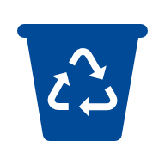
The 4R’s
Reuse - Reuse can be practiced easily by reusing an item again and again. Before you throw it away, take a moment and learn useful tips that will allow you to repurpose and reuse numerous items found in your home.
Recycle - The act of collecting and separating materials and products from the solid waste stream and reusing them as raw materials in manufacturing processes.

Slide 4
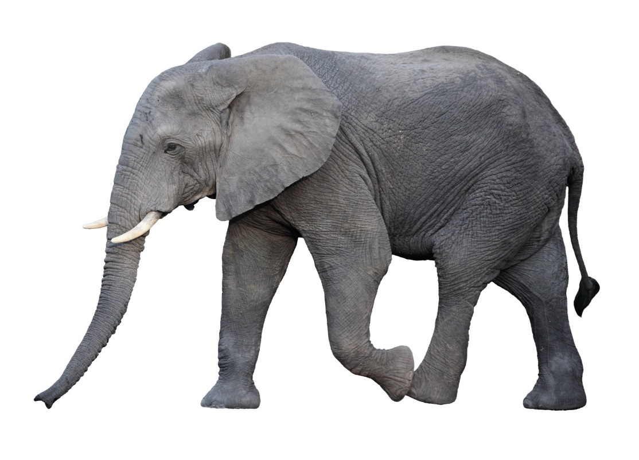
X 1,000
5,000
tons per day
wasted
materials
Notes:
In Franklin Co alone, about 5,000 tons of wasted material is landfilled each day. Since it’s hard to think in terms of tonnage, this is the equivalent to approximately 1,000 elephants.
We use the word “materials” and not garbage or trash, because most things that are landfilled are valuable materials that could be reduced, reused, recycled or even composted.

Slide 5
What’s Landfilled?
Notes:
Your next question may be, well what’s being landfilled?
This graphic reflects a current breakdown of materials being wasted in Franklin County.
Any guesses about what fibers are? Cardboard, printing paper, notebook paper, and construction paper are a few examples of fibers accepted locally for recycling. These types of materials can only be recycled so many times (about 4-5) before the fibers are too weak to continue to be recycled. An example of a fiber product at the end of its recyclable life is a cardboard egg container. Could this be reused?

Slide 6
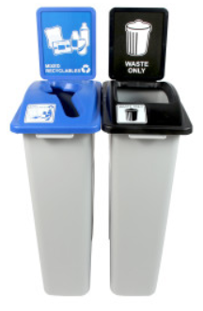
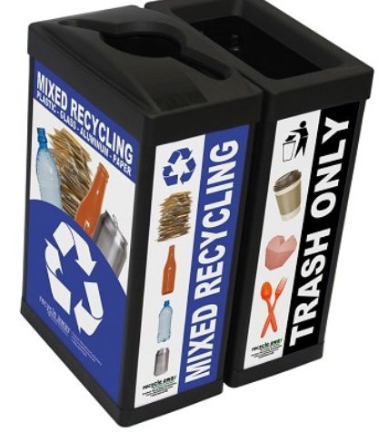
% of landfilled materials could be recycled/ recovered?
Notes:
Now I have a quiz for you:
What percentage of materials currently being landfilled do you think could have been recycled or recovered in Franklin County?
Although we recycle a large amount as a community, we still have a long way to go!
Over 76% of landfilled materials in Franklin County could have been diverted with current markets and infrastructure for a profit of approximately $23 million.
We have an amazing opportunity to increase recovery of these materials through increased access and education.

Slide 7
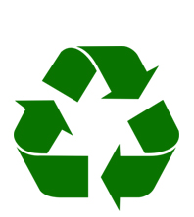
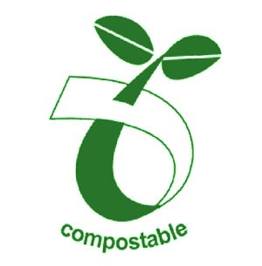
x200,000
1,000,000 tons
Notes:
It may sound pretty doom and gloom at this point. But, we have a lot of reasons to be proud of our community.
In Franklin county, we have over a 45% recycling and composting rate. The national average is only 34% - this is really encouraging!
We diverted almost 1,000,000 tons last year. This number is equivalent to the weight of approximately 200,000 elephants.
It’s inspiring to think we diverted this much material from the landfill last year!

Slide 8
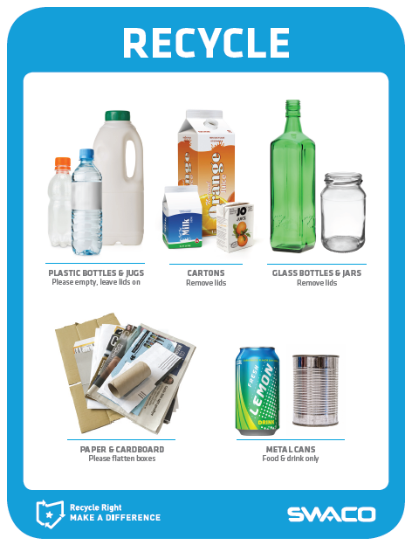
Notes:
Signage with images and simple text IS VERY IMPORTANT. The materials you see here are common materials recycled in our area.
There are certain items not accepted for recycling, NOT because they are not recyclable, but because there isn’t a viable, cost effective, market for the material. Some items that are not accepted in central
Ohio may be accepted in other parts of the country if there is a market participant willing to purchase the material.

Slide 9
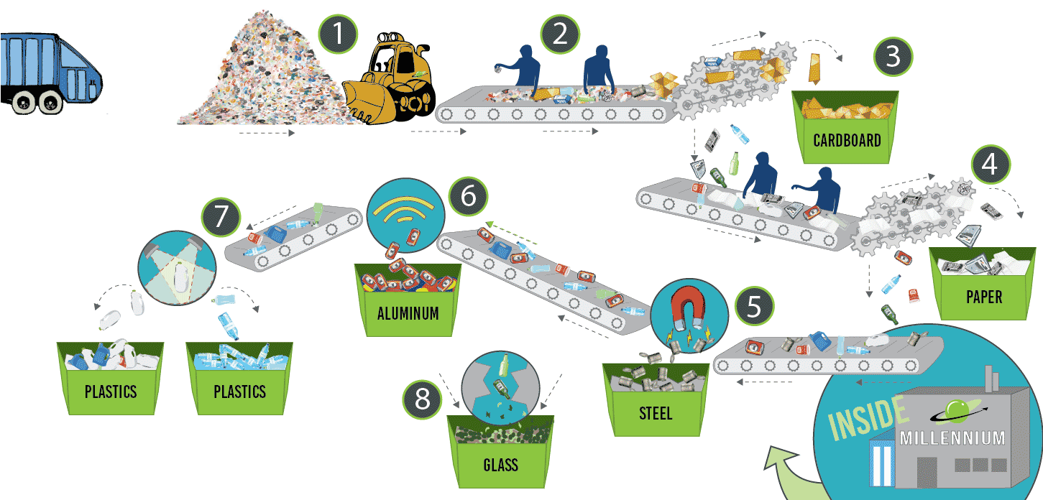
Materials Recovery Facility (MRF)
Click Here to view a video of the sorting process at Rumpke
Notes:
So, you may wonder, where do all these mixed recyclables go and how are they sorted?
In Franklin County, most of the single stream (mixed) recyclables are processed at Rumpke’s Columbus Material Recovery Facility (MRF). If your hauler is Waste Management, they have their own MRF that sorts recyclable materials. Once materials are sorted, they are sold to companies that make these materials into new products. Rumpke is not the recycler, but the sorter and hauler of many of these materials.
The first step of this process requires people to sort out contamination. Contamination can be dangerous or unaccepted materials like clothing, batteries, and food. Plastic bags are also a problem material for the sorting facilities because they easily rip and get caught in the machine gears. Be sure to recycle your plastic bags at a retail location, like a grocery store, near you and keep your recyclables empty, clean, and dry to keep the recycling process running smoothly.

Slide 10
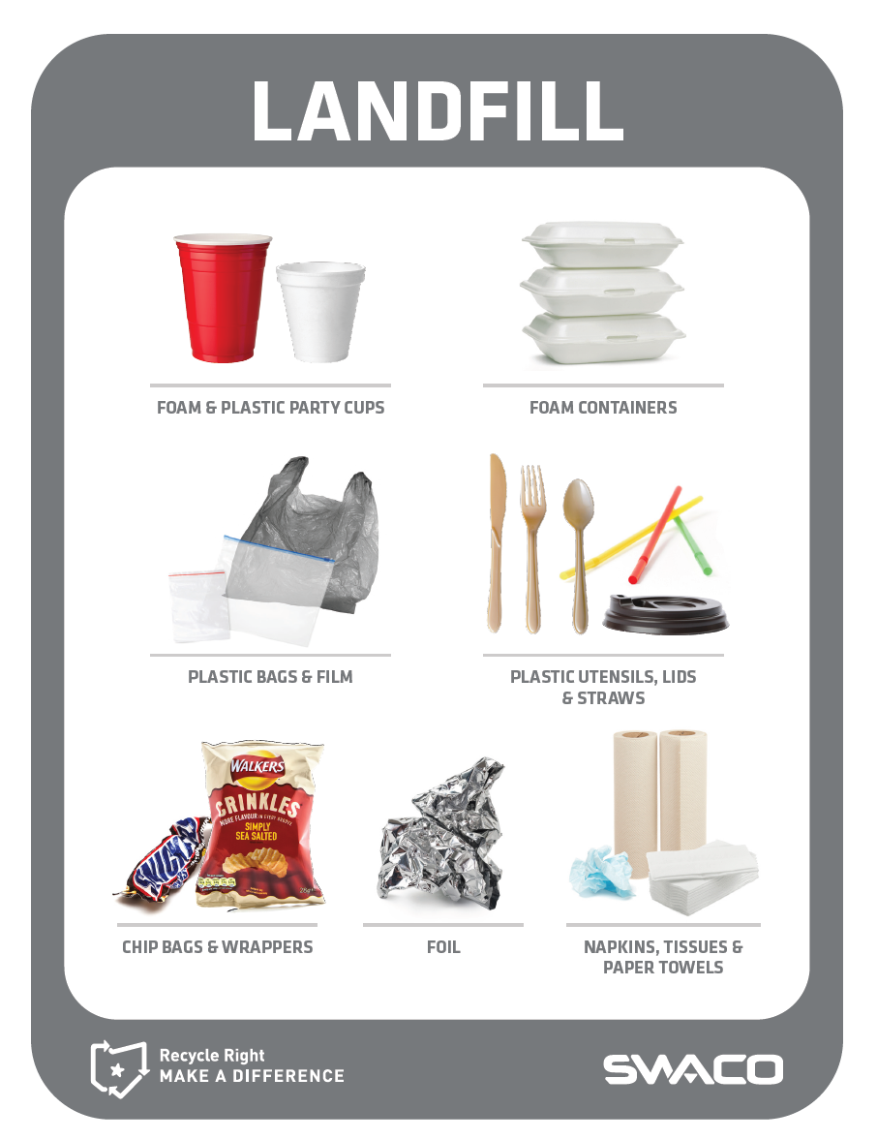
Notes:
Correct signage on the landfill containers is also important. These items are not accepted for curbside recycling in Franklin County. There are special recycling programs that may take some of these items though.

Slide 11
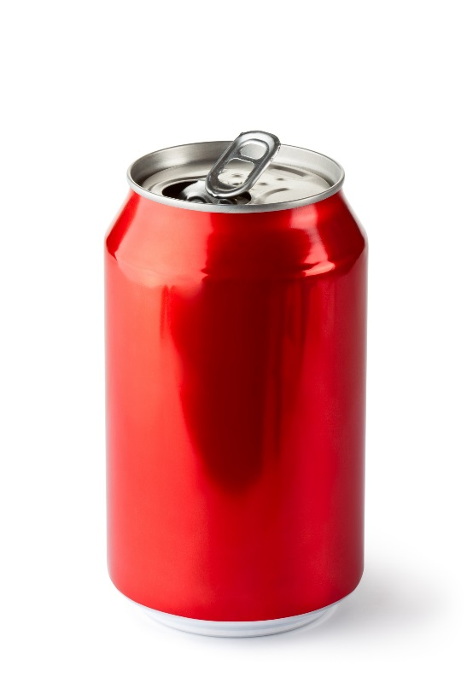
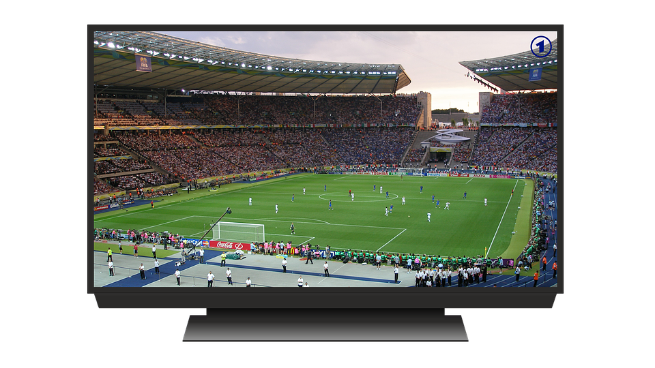
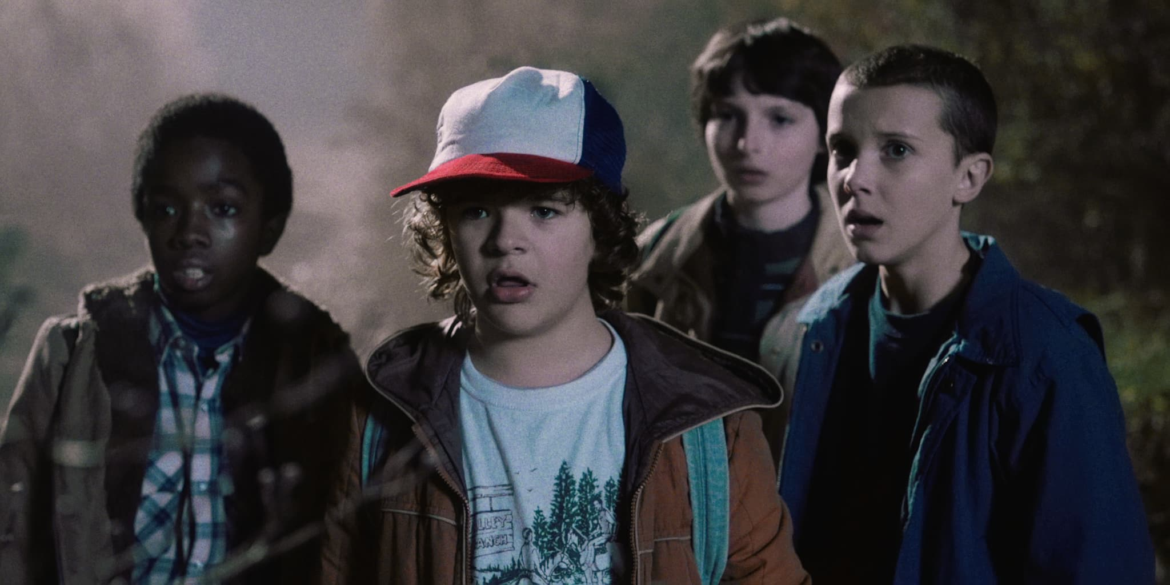
2 hours
Notes:
Rethinking, reducing, reusing and recycling saves natural resources. The amount of energy saved producing one can from recycled content as compared to virgin content, is enough to power a TV for 2 hours. Do you know how Ohio produces 90% of it’s electricity? Burning coal.
Creating goods from recycled content saves energy because it prevents the mining, transportation, and processing of virgin materials to make the item. Each step of the process extracting and processing virgin materials requires energy consumption which can be avoided by utilizing recycled content.
According to the Aluminum Association, nearly 75 percent of all aluminum produced in the U.S. is still in use today.
Source: EPA
Aluminum cans are recycled into new cans as well as car parts, window frames, wire, tubing and electronics. Aluminum placed in your recycling bin is more valuable than any other item in the recycling stream because it can be recycled endlessly without the material breaking down or decreasing in quality.

Slide 12
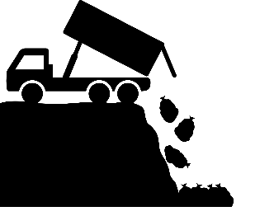


Transition from a Linear Economy…
Take
Dispose
Make
Notes:
Transitioning from our current system where we extract natural resources, make goods, and then landfill items…. Which is a very linear system, towards a…

Slide 13
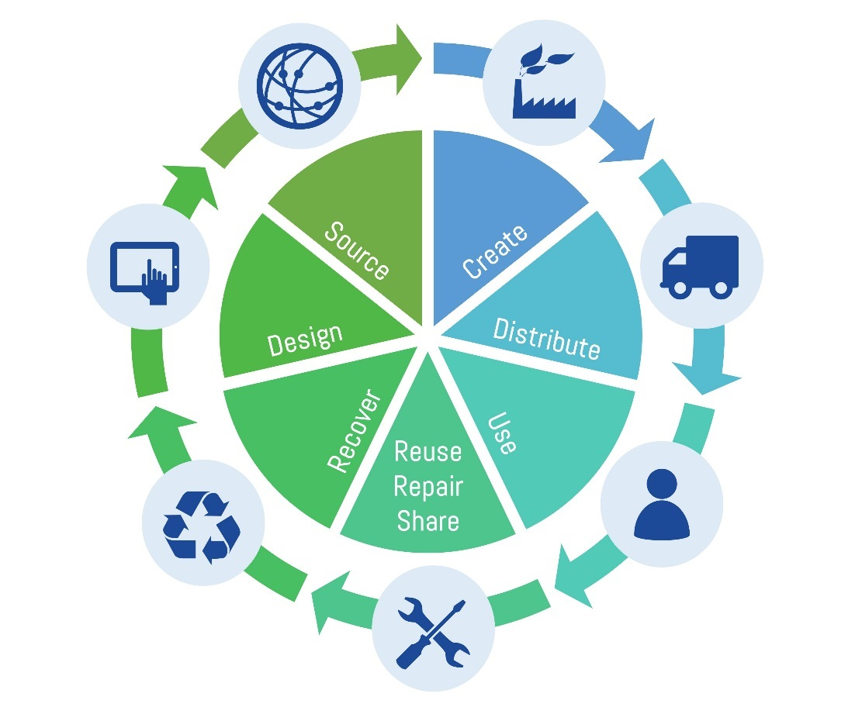
…Towards a Circular Economy
Notes:
….more circular and sustainable economy without landfilling materials. This is great for people & the planet.
Every day you can choose to 1) use resources wisely, 2) preserve the environment and habitats, and 3) help build a stronger local economy by reducing, reusing, and recycling!

Slide 14
Careers that you may consider to help make a difference
Notes:
As young people, you are in an important position to make a measurable difference and help lead our community towards a more sustainable future.
But what exactly does that mean?

Slide 15
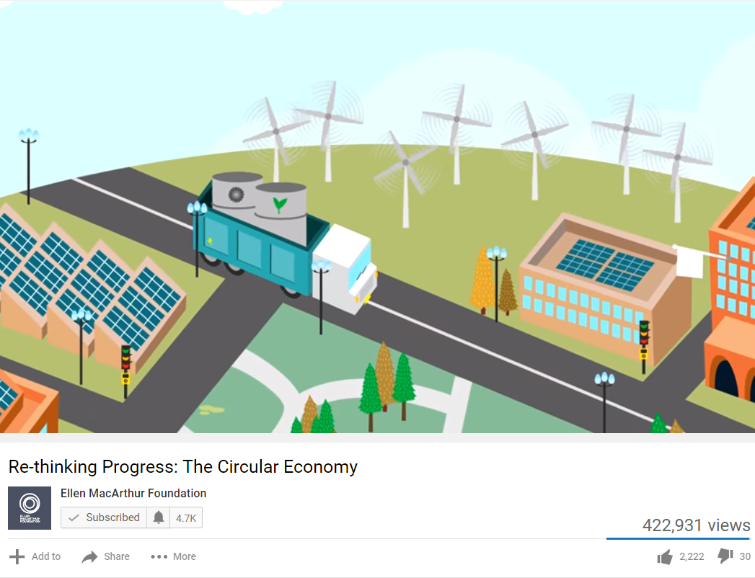
Click here to view this video
Notes:
These concepts are the future and people are already starting to help build a more circular economy.
When you start considering what you want to study in college or pursue as a career, you may consider a career that helps the movement.

Slide 16
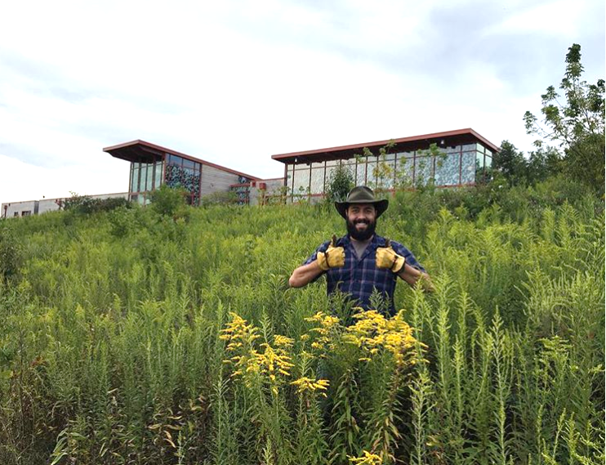
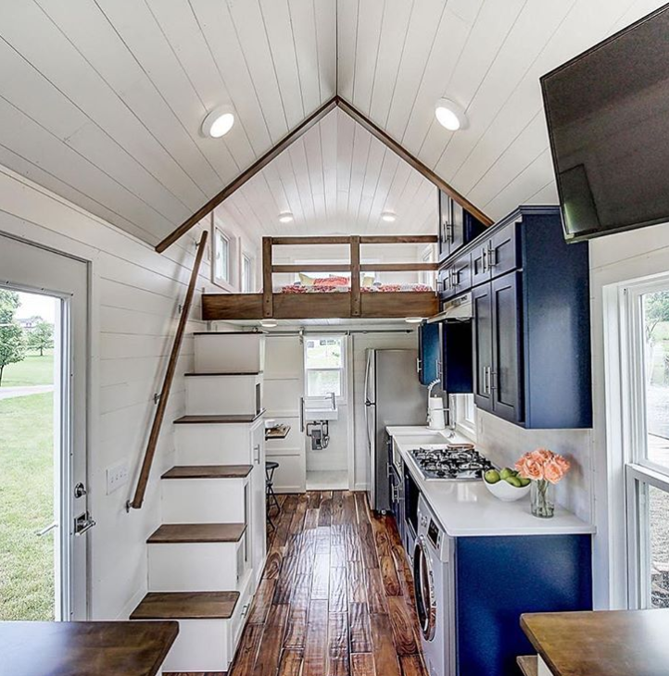

If you enjoy architecture…
Grange_Audubon
moderntinyliving
Design Waste-Free Buildings
Notes:
These concepts are the future, and people are already starting to help build a more circular economy.
When you start considering what you want to study in college or pursue as a career, you may consider a career that helps the movement.

Slide 17
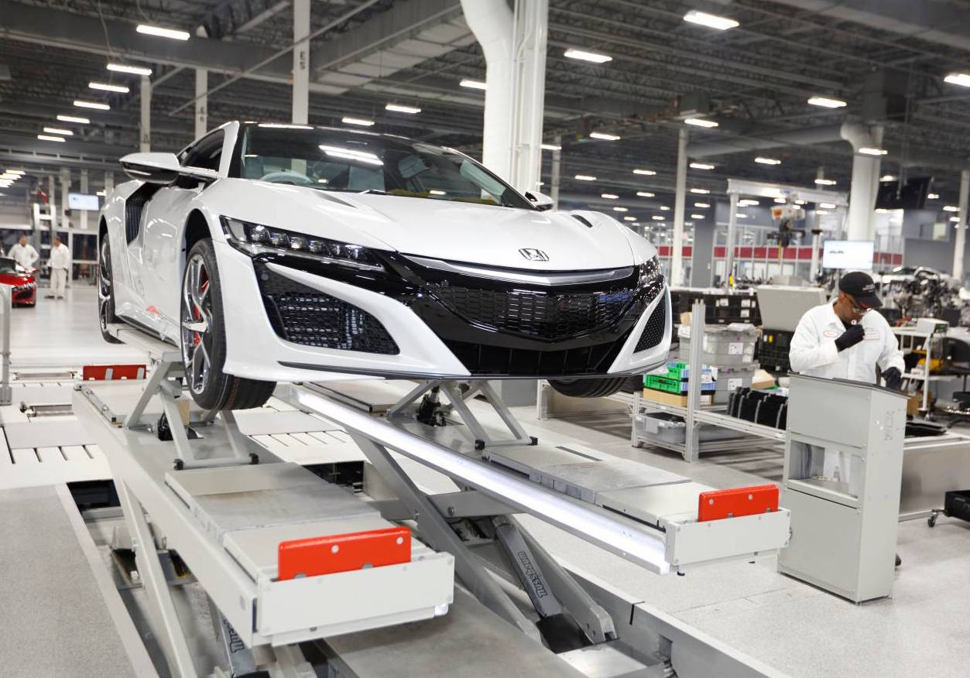
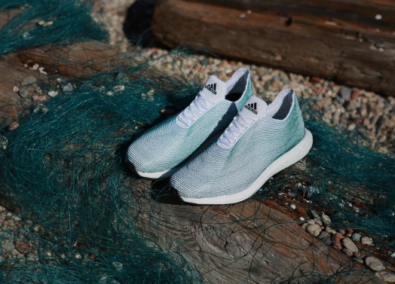
If you enjoy fixing things & solving problems…
Zero Waste Honda Facility, Ohio
Ocean Plastic Zero Waste Shoes
Engineer New Systems & Goods
Notes:
If you love fixing things and solving problems, you can engineer new systems and goods in line with the circular economy.
For example, the Honda manufacturing facilities in Ohio are zero waste! They design and build these vehicles while only landfilling 1% of all the materials they use!
You could also figure out how to turn ocean plastic pollution into new cool shoes like these from Adidas. People are behind these cools products and systems and that person could be you!
http://performancedrive.com.au/wp-content/uploads/2016/08/2017-Honda-NSX-production.jpg
https://www.fastcompany.com/3048033/adidas-knit-these-sneakers-entirely-from-ocean-plastic-trash

Slide 18
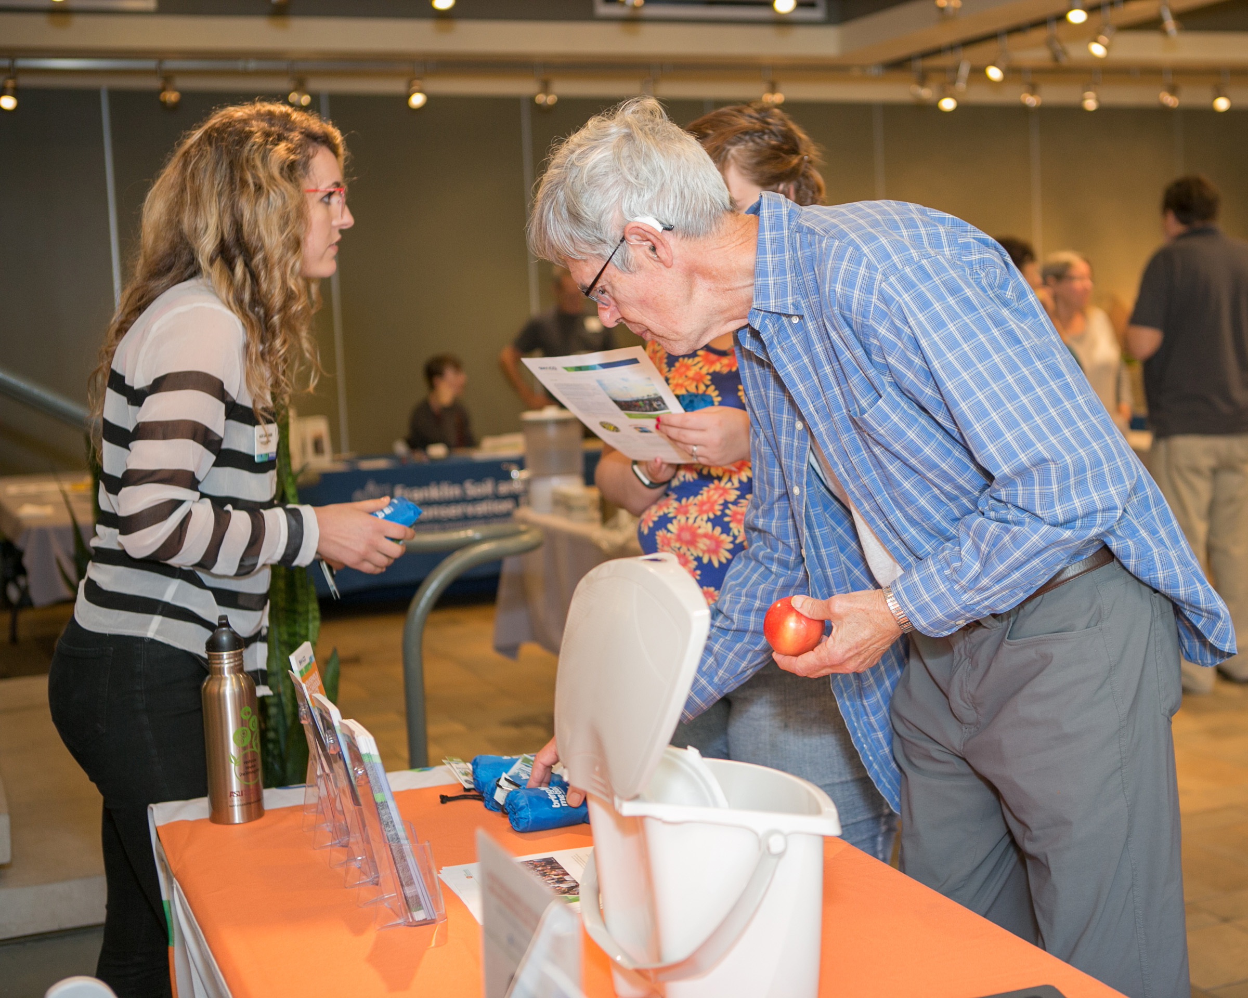
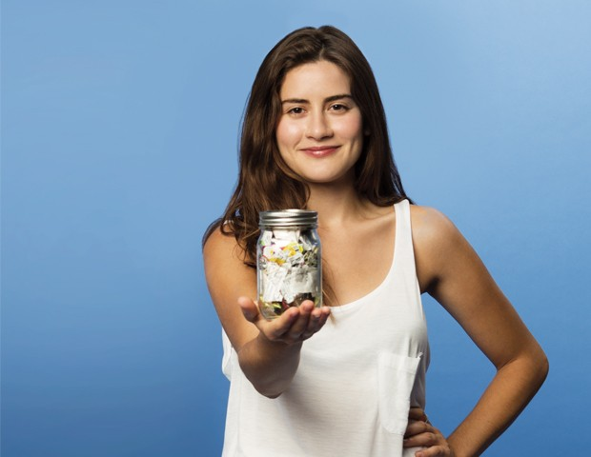
If you enjoy communications & teaching….
trashisfortossers
Educate about Environmental Topics
Notes:
If technology and design isn’t your thing but you love communicating and teaching others, you can get paid to educate! Raise your hand if you think this is something you may enjoy.
This may include educating people about recycling and composting. SWACO, the OEPA, Franklin Soil and Waster Conservation District and Parks all offer these types of programs.
Another job is being the spokes person for a movement like this girl who went zero waste and tells her story through multiple mediums online to inspire others to reduce their waste too. https://youtu.be/ZT0uqEPzbd0

Slide 19
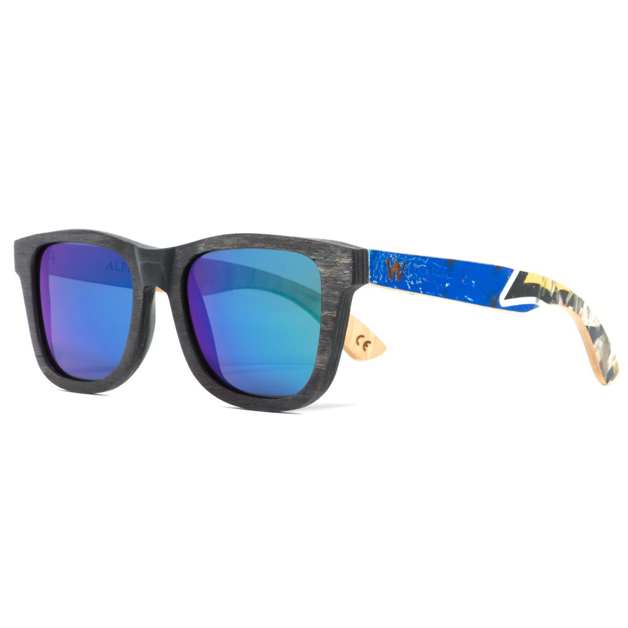
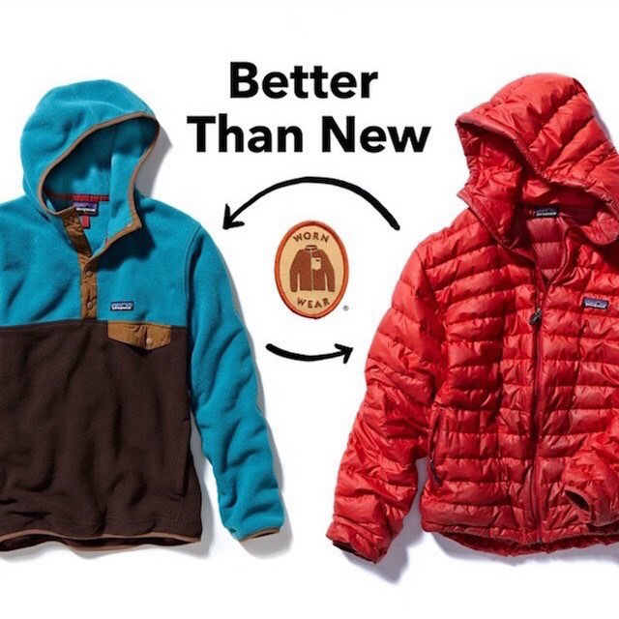
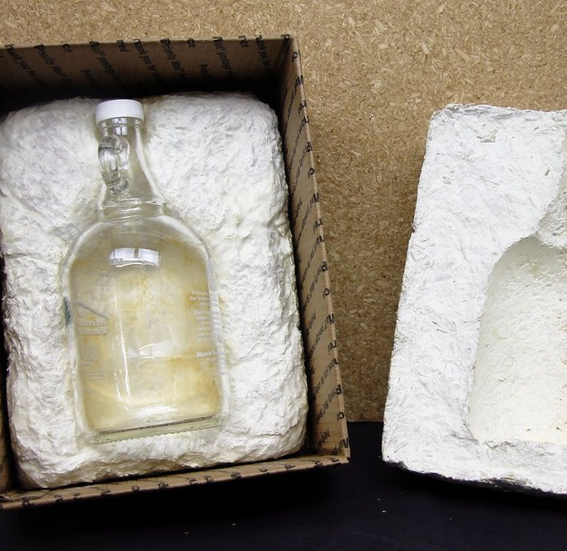
If you like business…
ecovative
woodzeeinc
Create or Join a Sustainable Business
Notes:
Lastly, there are a ton of companies that are making money while creating a more sustainable world.
For example, Woodzee is a company that makes cool sunglasses from recycled skateboards. If you had a creative idea like this, you could be an entrepreneur and create your own company!
Or, you could always join a company that is already embracing circular economy ideas like Patagonia. Patagonia & North Face have programs where they help people fix their clothes that tear or break instead of encouraging them to buy new! This is how a circular economy company works!
Consider how you can create materials and packaging inspired by designs in nature. This concept is called biomimicry and helps create more sustainable goods that won’t contaminate the planet or hurt public health.
For example, a company called ecovative found a creative way to build packaging from fungi instead of Styrofoam, which is unnatural and never can fully go back into nature.
Now we will discuss other products made from recycled or reused materials! Teacher should share SWACO’s 4 R’s Kit.
Sources:
https://jamesmackeddie.com/2017/06/21/worn-wear/
https://www.woodzee.com/collections/mens-skateboard-sunglasses/products/sierra-recycled-skateboard-sunglasses-1
https://biomimicry.org/

Slide 20
Recycle Right and Make a Difference! Email schools@swaco.org to connect with us.

Slide 21
Teacher Notes
Side 4 | In Franklin Co alone, about 5,000 tons of wasted material is landfilled each day. Since it’s hard to think in terms of tonnage, this is the equivalent to approximately 1,000 elephants. We use the word “materials” and not garbage or trash, because most things that are landfilled are valuable materials that could be reduced, reused, recycled or even composted.
5 | Your next question may be, well what’s being landfilled? This graphic reflects a current breakdown of materials being wasted in Franklin County. Any guesses about what fibers are? Cardboard, printing paper, notebook paper, and construction paper are a few examples of fibers accepted locally for recycling. These types of materials can only be recycled so many times (about 4-5) before the fibers are too weak to continue to be recycled. An example of a fiber product at the end of its recyclable life is a cardboard egg container. Could this be reused?
6 | Now I have a quiz for you: What percentage of materials currently being landfilled do you think could have been recycled or recovered in Franklin County? Although we recycle a large amount as a community, we still have a long way to go! Over 76% of landfilled materials in Franklin County could have been diverted with current markets and infrastructure for a profit of approximately $23 million. We have an amazing opportunity to increase recovery of these materials through increased access and education.
7 | It may sound pretty doom and gloom at this point. But, we have a lot of reasons to be proud of our community. In Franklin county, we have over a 45% recycling and composting rate. The national average is only 34% - this is really encouraging! We diverted almost 1,000,000 tons last year. This number is equivalent to the weight of approximately 200,000 elephants. It’s inspiring to think we diverted this much material from the landfill last year!

Slide 22
Teacher Notes
Side 8 | Signage with images and simple text IS VERY IMPORTANT. The materials you see here are common materials recycled in our area. There are certain items not accepted for recycling, NOT because they are not recyclable, but because there isn’t a viable, cost effective, market for the material. Some items that are not accepted in central Ohio may be accepted in other parts of the country if there is a market participant willing to purchase the material.
9 | So, you may wonder, where do all these mixed recyclables go and how are they sorted? In Franklin County, most of the single stream (mixed) recyclables are processed at Rumpke’s Columbus Material Recovery Facility (MRF). If your hauler is Waste Management, they have their own MRF that sorts recyclable materials. Once materials are sorted, they are sold to companies that make these materials into new products. Rumpke is not the recycler, but the sorter and hauler of many of these materials. The first step of this process requires people to sort out contamination. Contamination can be dangerous or unaccepted materials like clothing, batteries, and food. Plastic bags are also a problem material for the sorting facilities because they easily rip and get caught in the machine gears. Be sure to recycle your plastic bags at a retail location, like a grocery store, near you and keep your recyclables empty, clean, and dry to keep the recycling process running smoothly.
10 | Correct signage on the landfill containers is also important. These items are not accepted for curbside recycling in Franklin County. There are special recycling programs that may take some of these items though.
11 | Rethinking, reducing, reusing and recycling saves natural resources. The amount of energy saved producing one can from recycled content as compared to virgin content, is enough to power a TV for 2 hours. Do you know how Ohio produces 90% of it’s electricity? Burning coal. Creating goods from recycled content saves energy because it prevents the mining, transportation, and processing of virgin materials to make the item. Each step of the process extracting and processing virgin materials requires energy consumption which can be avoided by utilizing recycled content. According to the Aluminum Association, nearly 75 percent of all aluminum produced in the U.S. is still in use today. Source: EPA Aluminum cans are recycled into new cans as well as car parts, window frames, wire, tubing and electronics. Aluminum placed in your recycling bin is more valuable than any other item in the recycling stream because it can be recycled endlessly without the material breaking down or decreasing in quality.
Notes:
8

Slide 23
Teacher Notes
12 | Transitioning from our current system where we extract natural resources, make goods, and then landfill items…. Which is a very linear system, towards a…
13 | ….more circular and sustainable economy without landfilling materials. This is great for people & the planet. Every day you can choose to 1) use resources wisely, 2) preserve the environment and habitats, and 3) help build a stronger local economy by reducing, reusing, and recycling!
14 | As young people, you are in an important position to make a measurable difference and help lead our community towards a more sustainable future. But what exactly does that mean?
15 | These concepts are the future, and people are already starting to help build a more circular economy. When you start considering what you want to study in college or pursue as a career, you may consider a career that helps the movement.
16 | These concepts are the future and people are already starting to help build a more circular economy. When you start considering what you want to study in college or pursue as a career, you may consider a career that helps the movement.
17 | If you love fixing things and solving problems, you can engineer new systems and goods in line with the circular economy. For example, the Honda manufacturing facilities in Ohio are zero waste! They design and build these vehicles while only landfilling 1% of all the materials they use! You could also figure out how to turn ocean plastic pollution into new cool shoes like these from Adidas. People are behind these cool products and systems and that person could be you! http://performancedrive.com.au/wp-content/uploads/2016/08/2017-Honda-NSX-production.jpg https://www.fastcompany.com/3048033/adidas-knit-these-sneakers-entirely-from-ocean-plastic-trash

Slide 24
Teacher Notes
18 | If technology and design isn’t your thing but you love communicating and teaching others, you can get paid to educate! Raise your hand if you think this is something you may enjoy. This may include educating people about recycling and composting. SWACO, the OEPA, Franklin Soil and Waster Conservation District and Parks all offer these types of programs. Another job is being the spokesperson for a movement like this girl who went zero waste and tells her story through multiple mediums online to inspire others to reduce their waste too. Https://youtu.be/ZT0uqEPzbd0
19 | Lastly, there are a ton of companies that are making money while creating a more sustainable world. For example, Woodzee is a company that makes cool sunglasses from recycled skateboards. If you had a creative idea like this, you could be an entrepreneur and create your own company! Or, you could always join a company that is already embracing circular economy ideas like Patagonia. Patagonia & North Face have programs where they help people fix their clothes that tear or break instead of encouraging them to buy new! This is how a circular economy company works! Consider how you can create materials and packaging inspired by designs in nature. This concept is called biomimicry and helps create more sustainable goods that won’t contaminate the planet or hurt public health. For example, a company called Ecovative found a creative way to build packaging from fungi instead of Styrofoam, which is unnatural and never can fully go back into nature. Sources: https://jamesmackeddie.com/2017/06/21/worn-wear/ https://www.woodzee.com/collections/mens-skateboard-sunglasses/products/sierra-recycled-skateboard-sunglasses-1 https://biomimicry.org/

