Slide 1
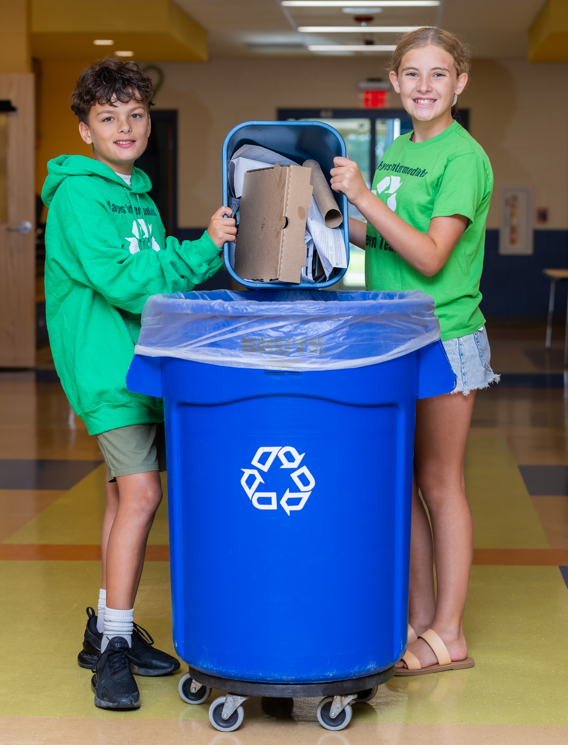

Introduction to Recycling
Grades 2-4
Teacher notes are on slides 19 and 20
Notes:
Teacher notes are on slides 19 and 20

Slide 2
Recycling
What is it?
What can be recycled?
Notes:
Ask students these questions. Gather background knowledge.

Slide 3
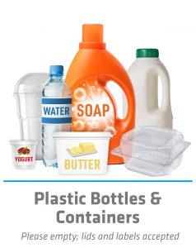
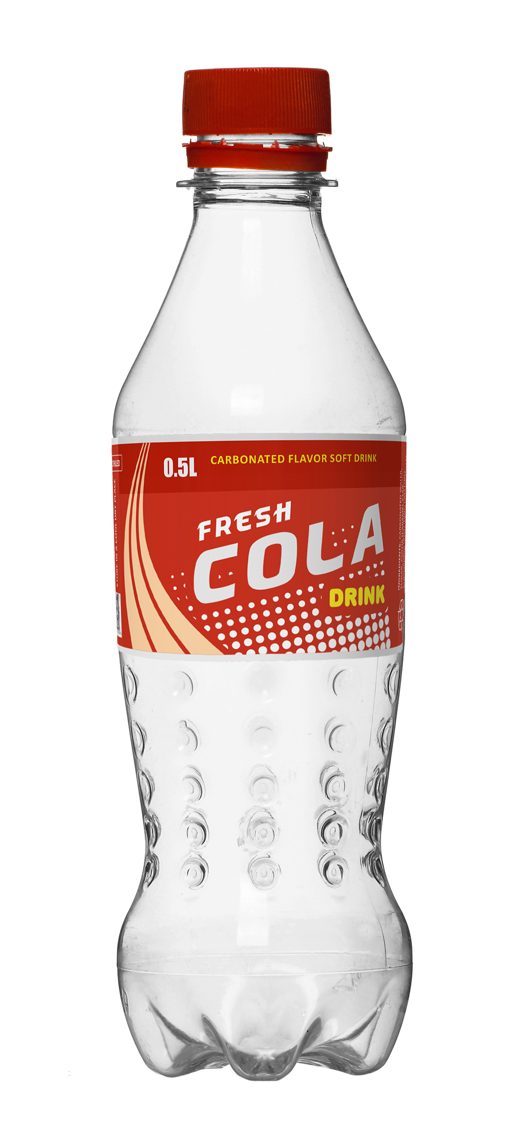
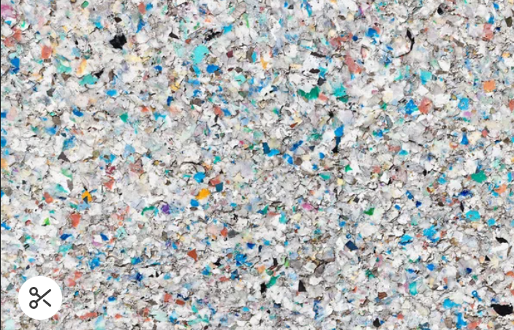
Recycling is the process of collecting and processing materials that would otherwise be thrown away as trash and turning them into new products.
(US-EPA)
Notes:
When you recycle plastic bottles and containers, they can be shredded into plastic pellets and turned back into a new plastic bottle.

Slide 4



Do you know a symbol that represents recycling?
This is a common recycling symbol you might see in many different colors.
The recycling symbol does not mean it can be recycled in your area. Always check with your hauler to understand what materials they collect.
Notes:
Ask students, “Where have your seen this symbol before?” Have students share out responses. (recycling bins, curbside bins, plastic bottles, cardboard boxes, Amazon packages, pop bottles, notebooks, food containers).

Slide 5
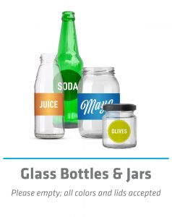
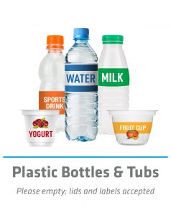
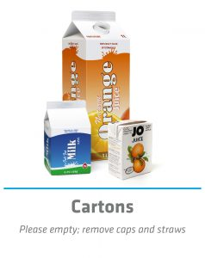
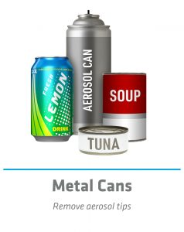
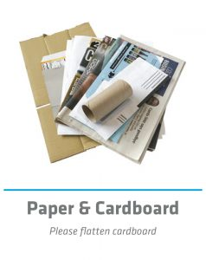
Common Materials Recycled
Notes:
Ask: what types of things can be recycled? See if they can name specific items or types of materials before revealing the answers. Note: what is accepted in YOUR school recycling depends on who picks it up and where they take it to. If the hauler takes it to RUMPKE, all of these items are accepted.

Slide 6
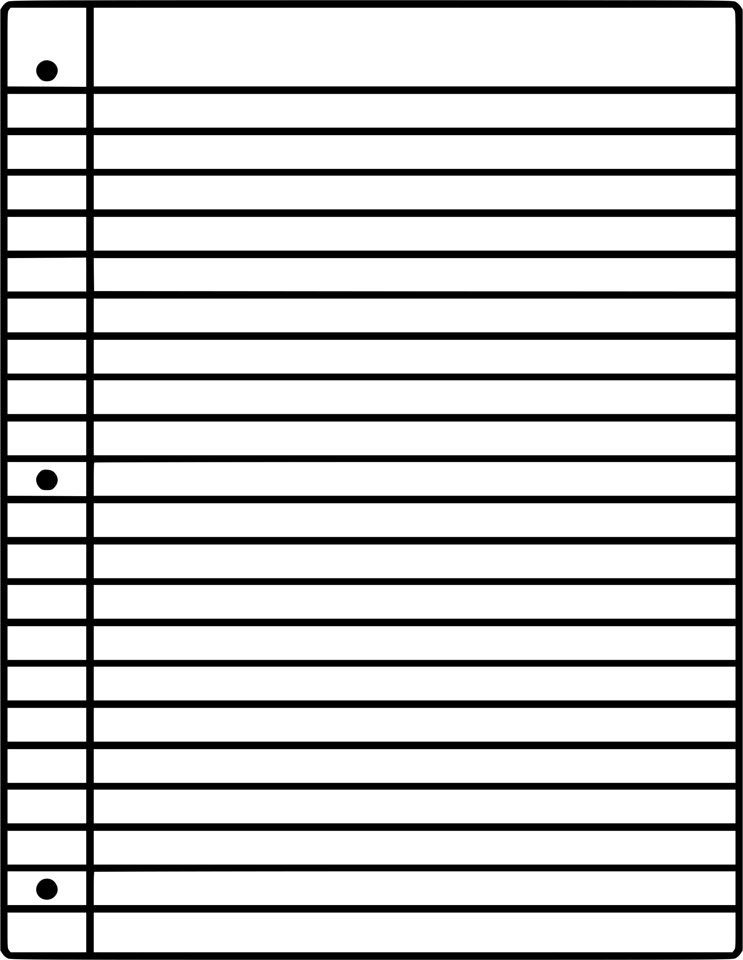
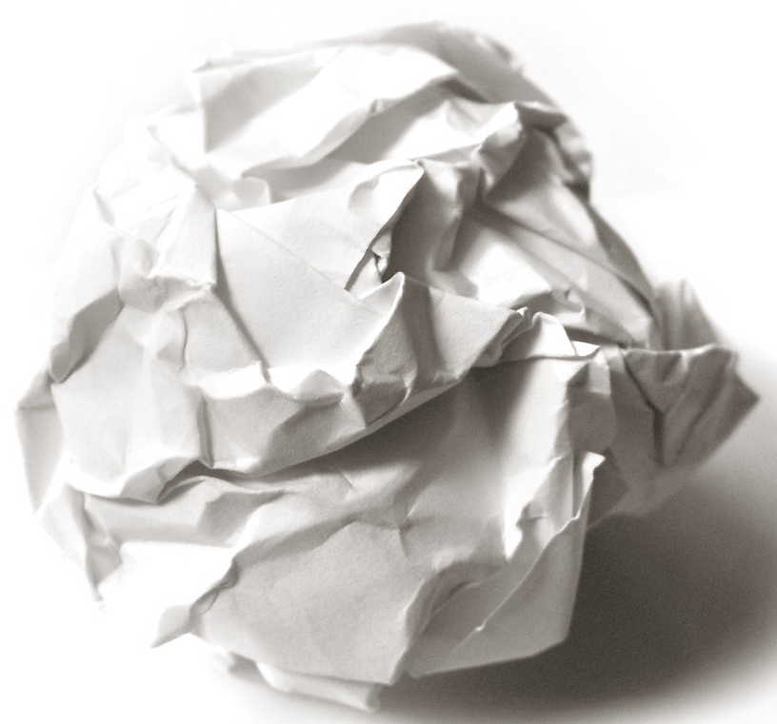
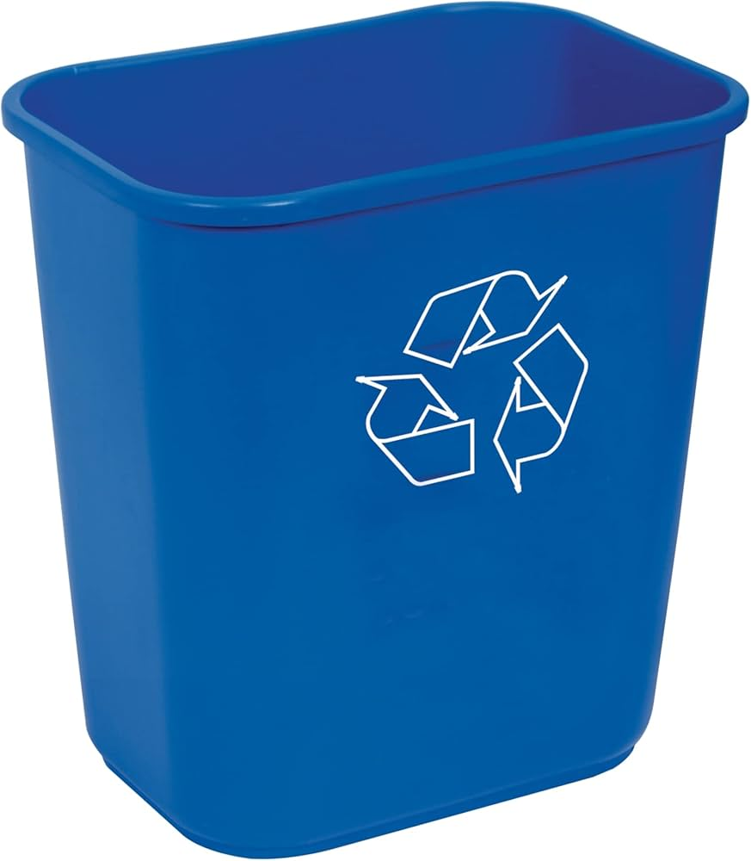
Journey of a Piece of Paper
Where does it go?
Notes:
After you are finished with your paper, what do you do with it? Have students share out (use it as scrap, recycle it, trash it…) Say: “Paper is recyclable, so hopefully you put it in the recycling bin at school or home. Where does it go after that?”

Slide 7
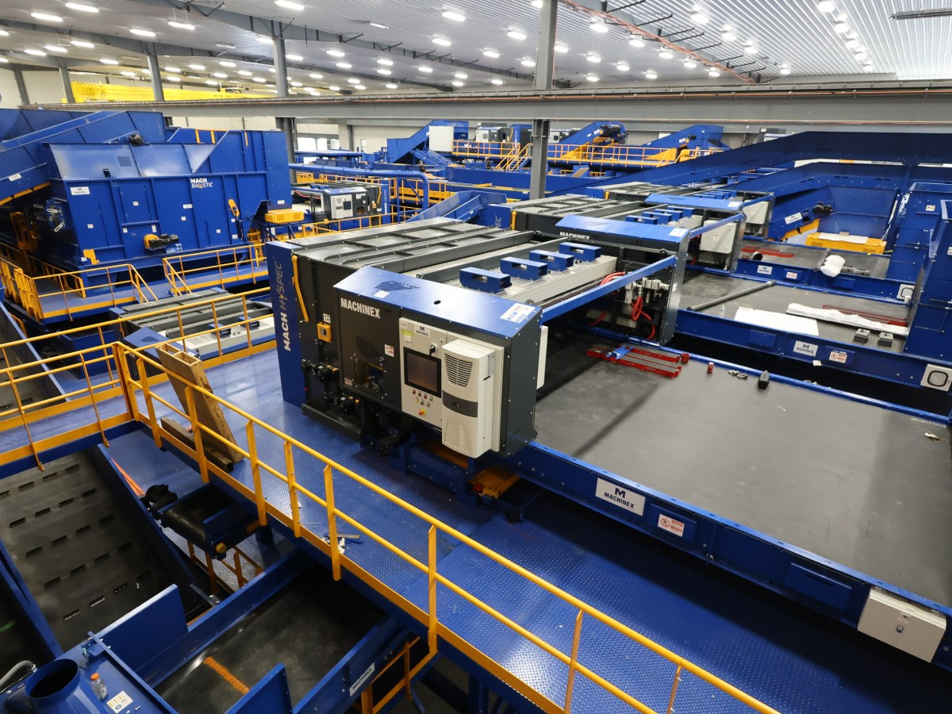
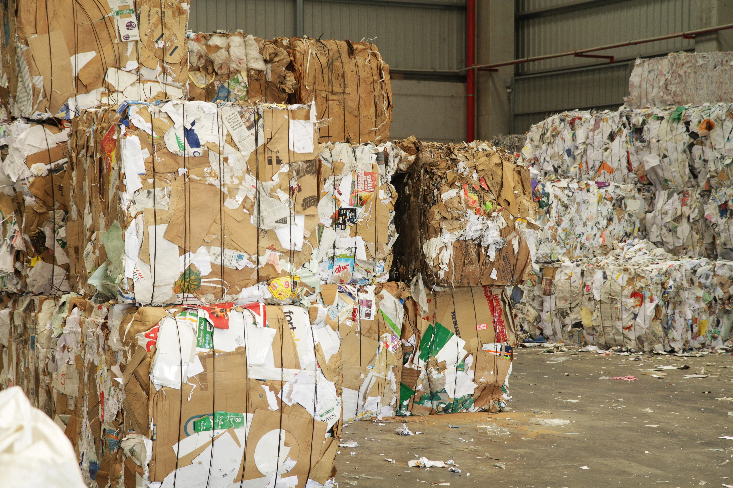
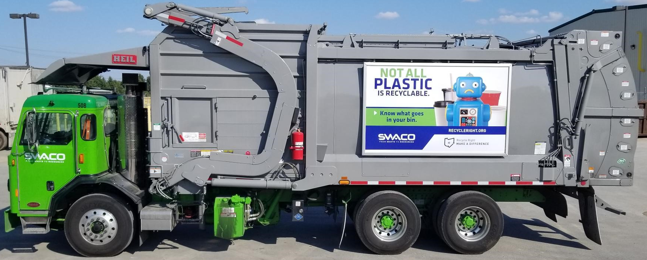
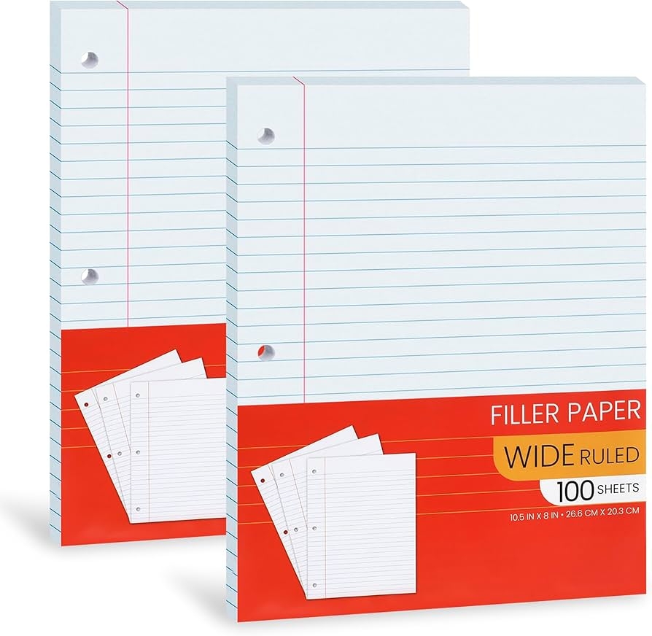
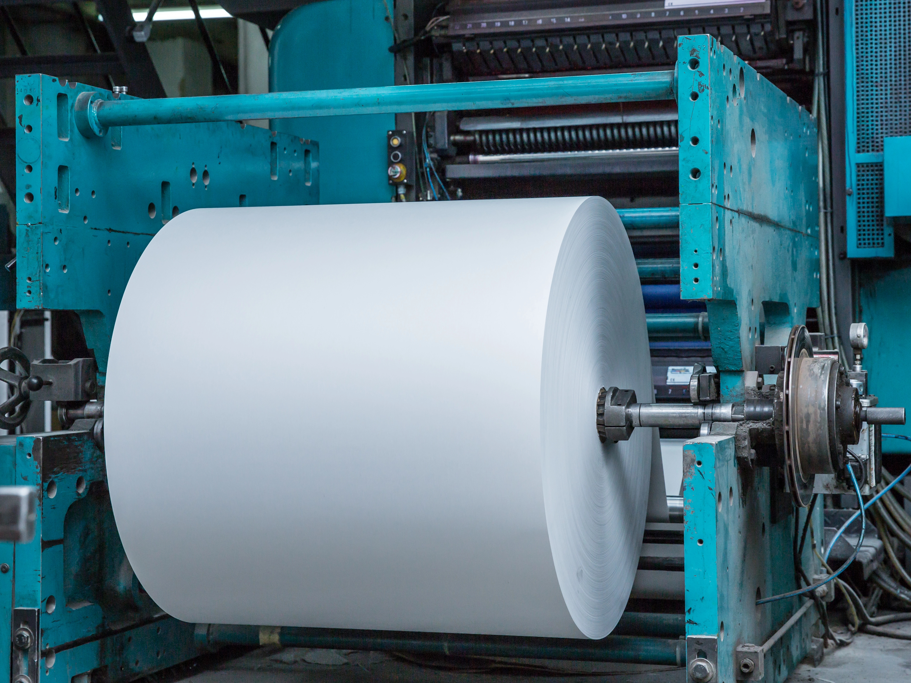

1
2
3
4
5
6
Notes:
It is taken outside to a recycling dumpster onsite 1. picked up by a recycling truck 2. taken to a MRF (pronounced Merf – Materials Recovery Facility). MRFs take the materials and use machines or people to sort them by their material types 3. the materials get bailed and sold to a recycling company 4. The paper gets sent to a paper mill where it is made into pulp then pressed back into paper 5. Finally, it can be made into special shapes, sizes, and colors of paper and sold 6. So students like you get to write more amazing stories, poems, solve math problems, plan out inventions, and more.

Slide 8
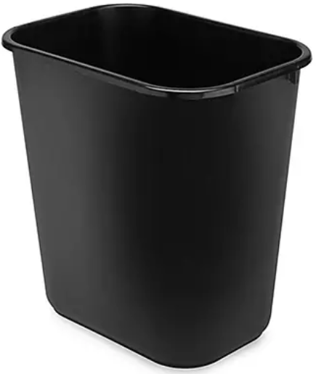
If You Trash It… Where Does it Go?
Where does it go?
Notes:
It goes to the landfill, where it cannot be reused or recycled….ever!!!

Slide 9

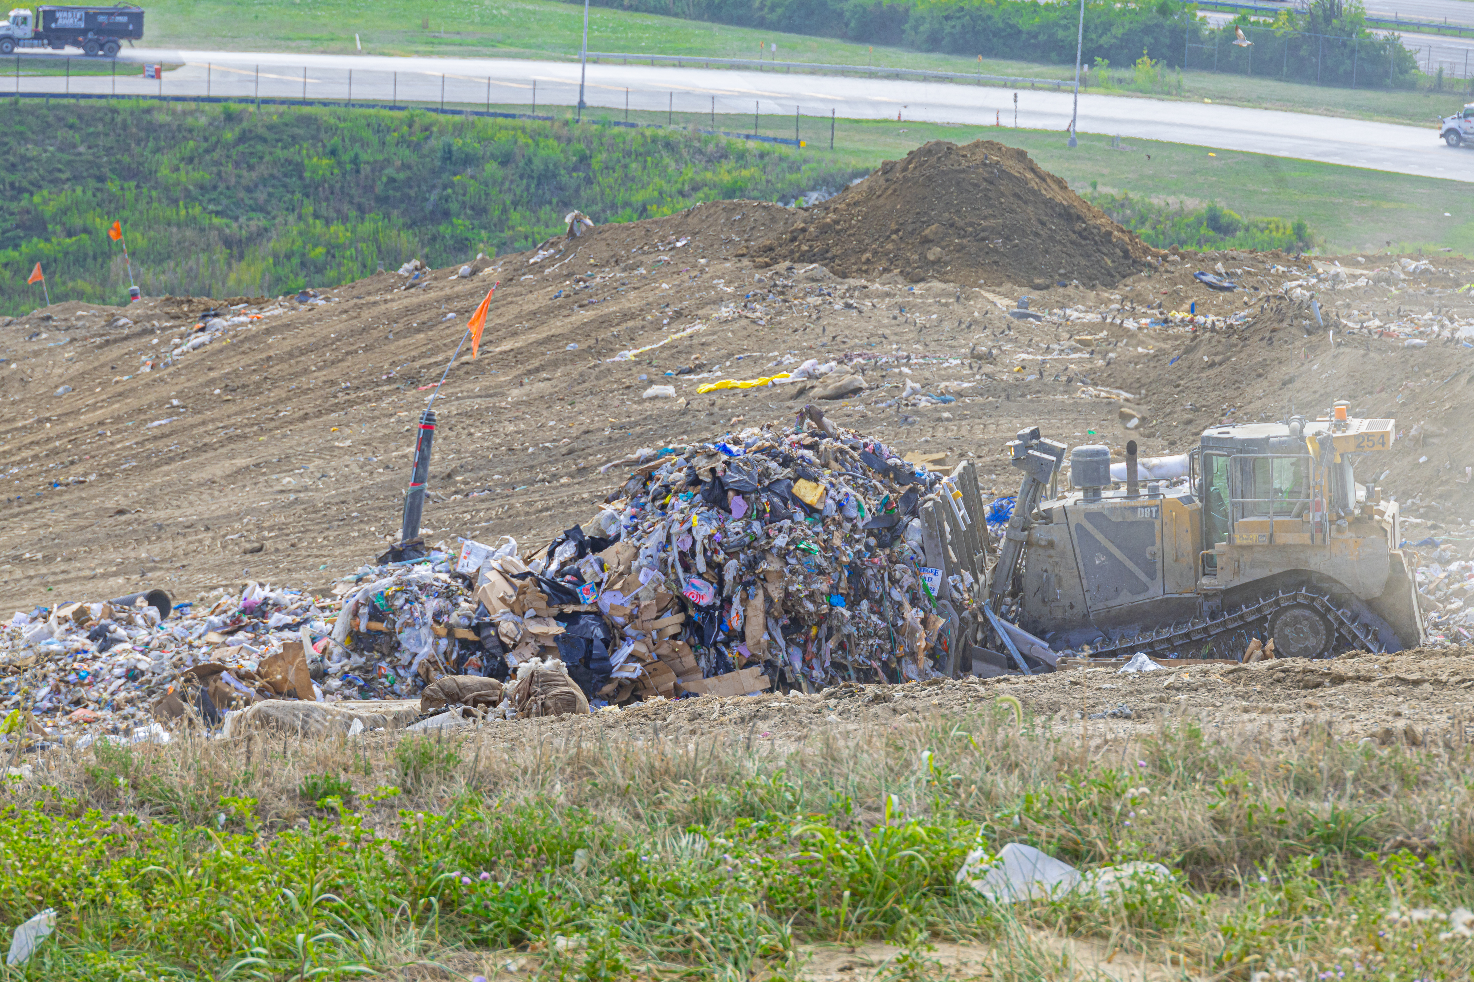
… To the Franklin County Sanitary Landfill
Grove City, OH
Buried = not made into new products.
Notes:
When you throw things away in your trash at home or school, it all comes to the Franklin County Sanitary Landfill in Grove City. It is owned and operated by SWACO (Solid Waste Authority of Central Ohio). The natural resources it took (trees) to make the paper is no longer able to be used.

Slide 10
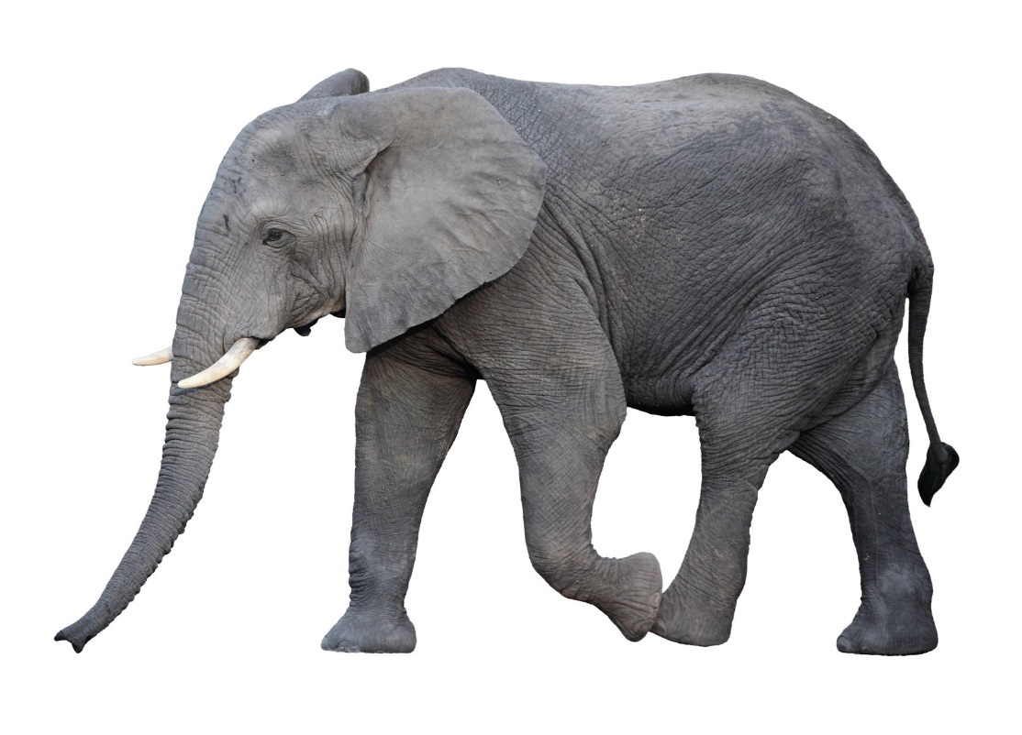
How Much Trash Comes to the Landfill Daily?
5,000
tons per day of
wasted
materials
That is like 1,000 elephants
Notes:
Imagine 1,000 elephants marching into the landfill every day. That’s how much trash is dumped each day in just OUR landfill in Franklin County. Imagine how much more is dumped in other landfills in Ohio daily. The total is 10,000,000 pounds a day.

Slide 11
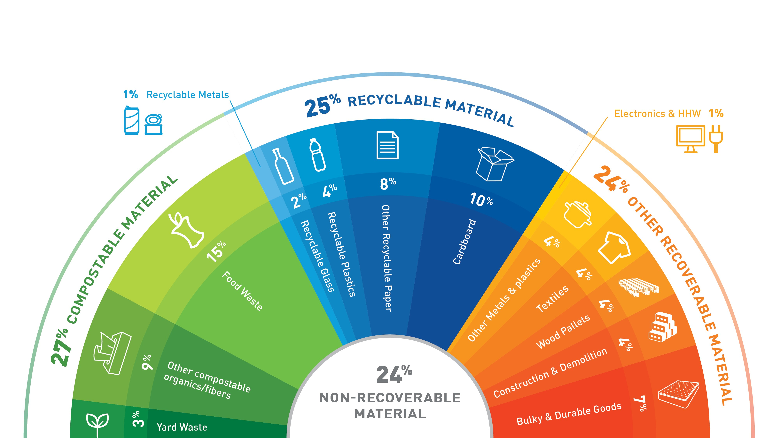
Materials that End Up in the Landfill
Notes:
Here is a chart that shows us the types of materials that are being thrown away at our landfill. What do you notice? Take a few minutes to discuss this chart with your class.
76% (more than half) of the items that come to the landfill in Franklin County, COULD be recycled. That’s 3 out of every 4 materials could be recycled. Only 24% or 1 out of 4 materials is what we consider to be truly trash (cannot be recycled).
You may even be surprised to see that food waste and cardboard are the top two contributors by percentage. Food waste makes up about 15% and cardboard is 10% of the total waste stream. WE have an amazing opportunity to increase recovery of these materials through increased access and education.

Slide 12

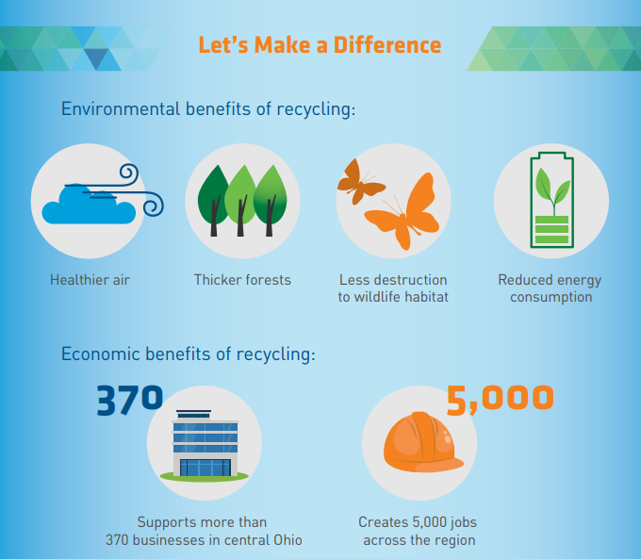
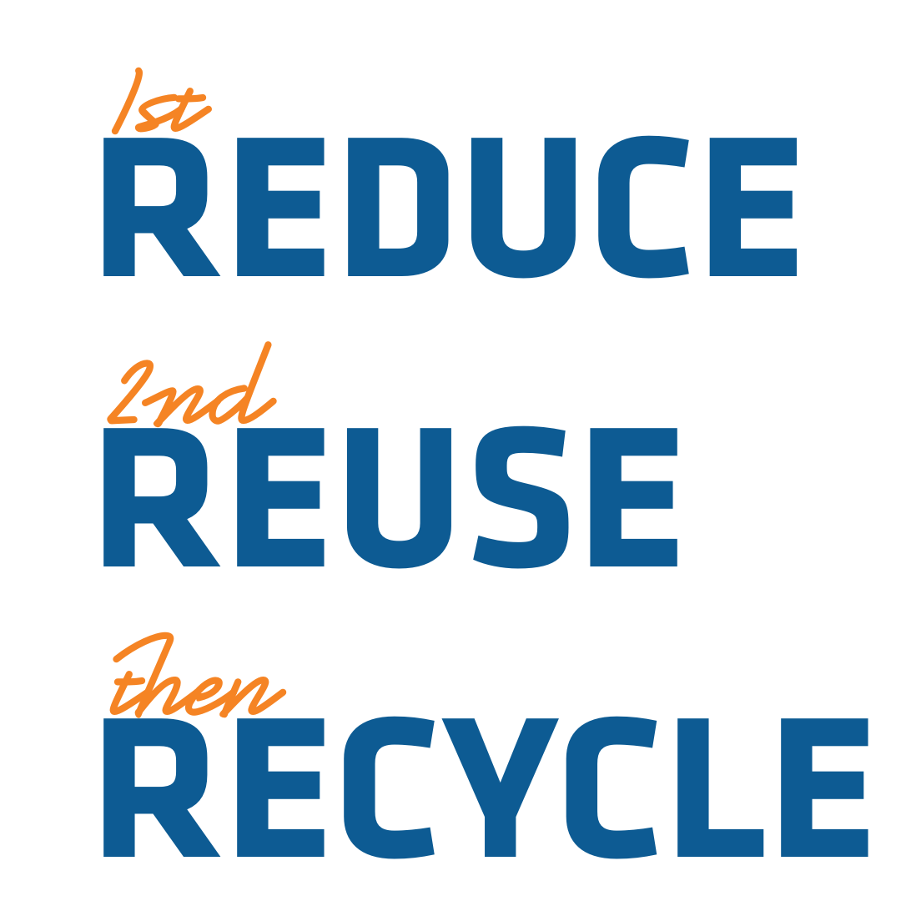
There are Benefits of Recycling
Notes:
This is why it is so important to reduce, reuse, and recycle. There are many other benefits to recycling other than just keeping our landfill from filling up too quickly.

Slide 13
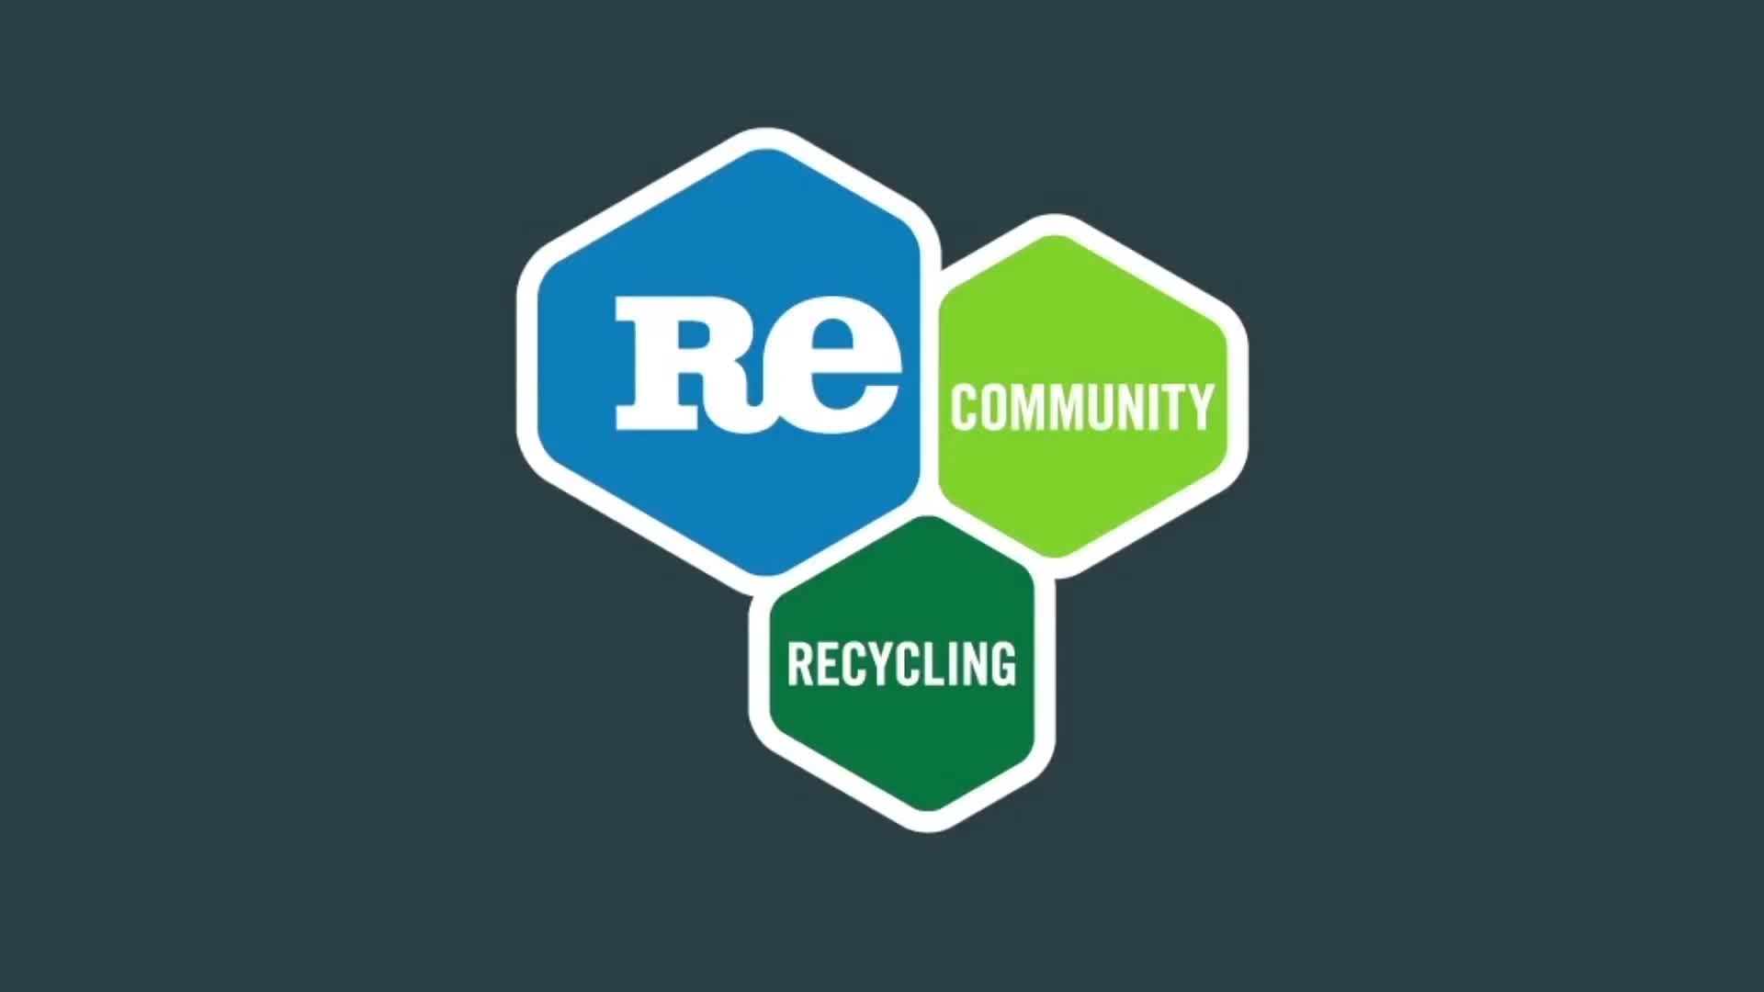
Where Does the Recycling Go?
Notes:
Let’s watch a short video to find out what happens after recyclables are picked up and hauled away. Click here if the video doesn’t work.

Slide 14
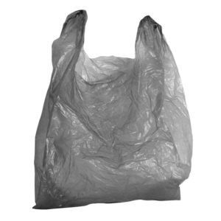
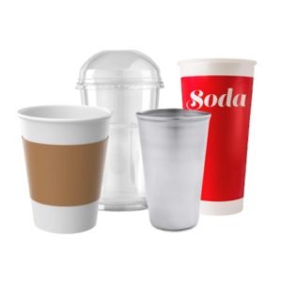
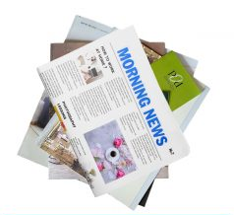
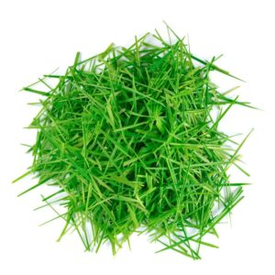
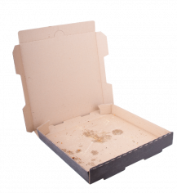
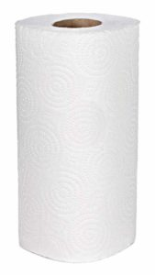
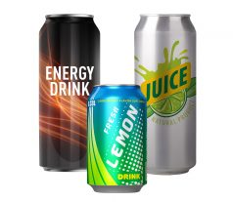
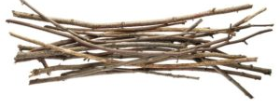
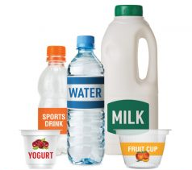
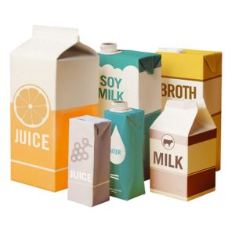
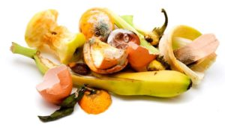
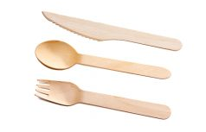
Let’s Review: What Can We Recycle at School?
Answers on next slide
Notes:
Call on students to call out or circle items that can be recycled at school.
Answers: Paper, cardboard, tubs, cups, cartons (made from paper, plastic or aluminum), cans. Greasy pizza boxes are accepted now!
Grass clippings and twigs can be composted or put in yard waste collection. Food scraps can be composted or thrown in the trash if composting at school is not available. Plastic bags should be collected and taken back to the store. Plastic silverware goes in the trash. Certain types are compostable. Paper towels are trash or compostable.
Answers on next slide.

Slide 15

Answer Key: What Can We Recycle at School?
Notes:
Answers: Paper, cardboard, tubs, cups, cartons (made from paper, plastic or aluminum), cans. Greasy pizza boxes are accepted now!
Grass clippings and twigs can be composted or put in yard waste collection. Food scraps can be composted or thrown in the trash if composting at school is not available. Plastic bags should be collected and taken back to the store. Plastic silverware goes in the trash. Certain types are compostable. Paper towels are trash or compostable.

Slide 16
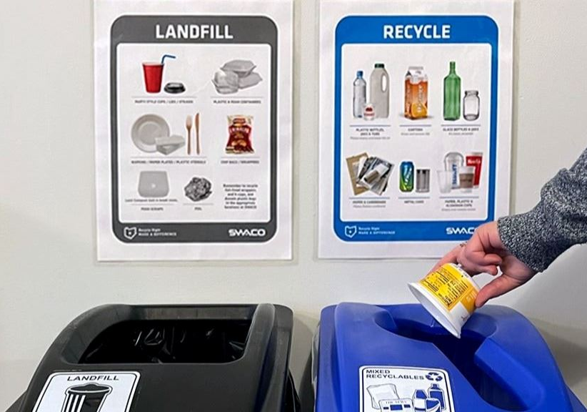
Recycle Right
Put your items in the correct bin.
Look at the signs to help you.
DO NOT put liquids in the recycling bin.
NO plastic bags should be in the recycling. Keep items loose.

Slide 17
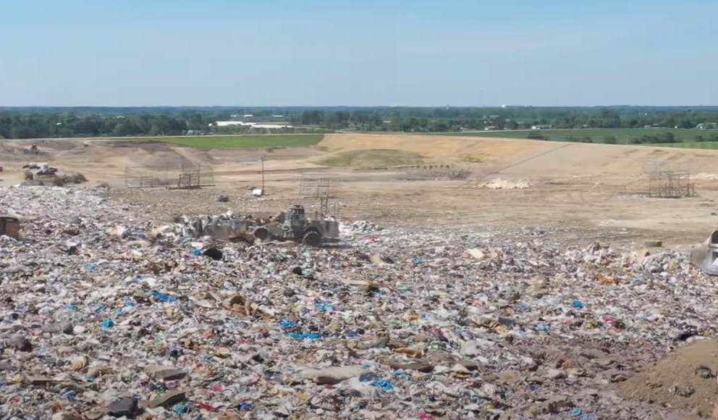
Teachers,
Check out our Free Landfill Tour!
SWACO Landfill Tours
*Bus reimbursement up to $220 for schools in Franklin County.
Schedule a Rumpke Recycling Center Tour

Slide 18
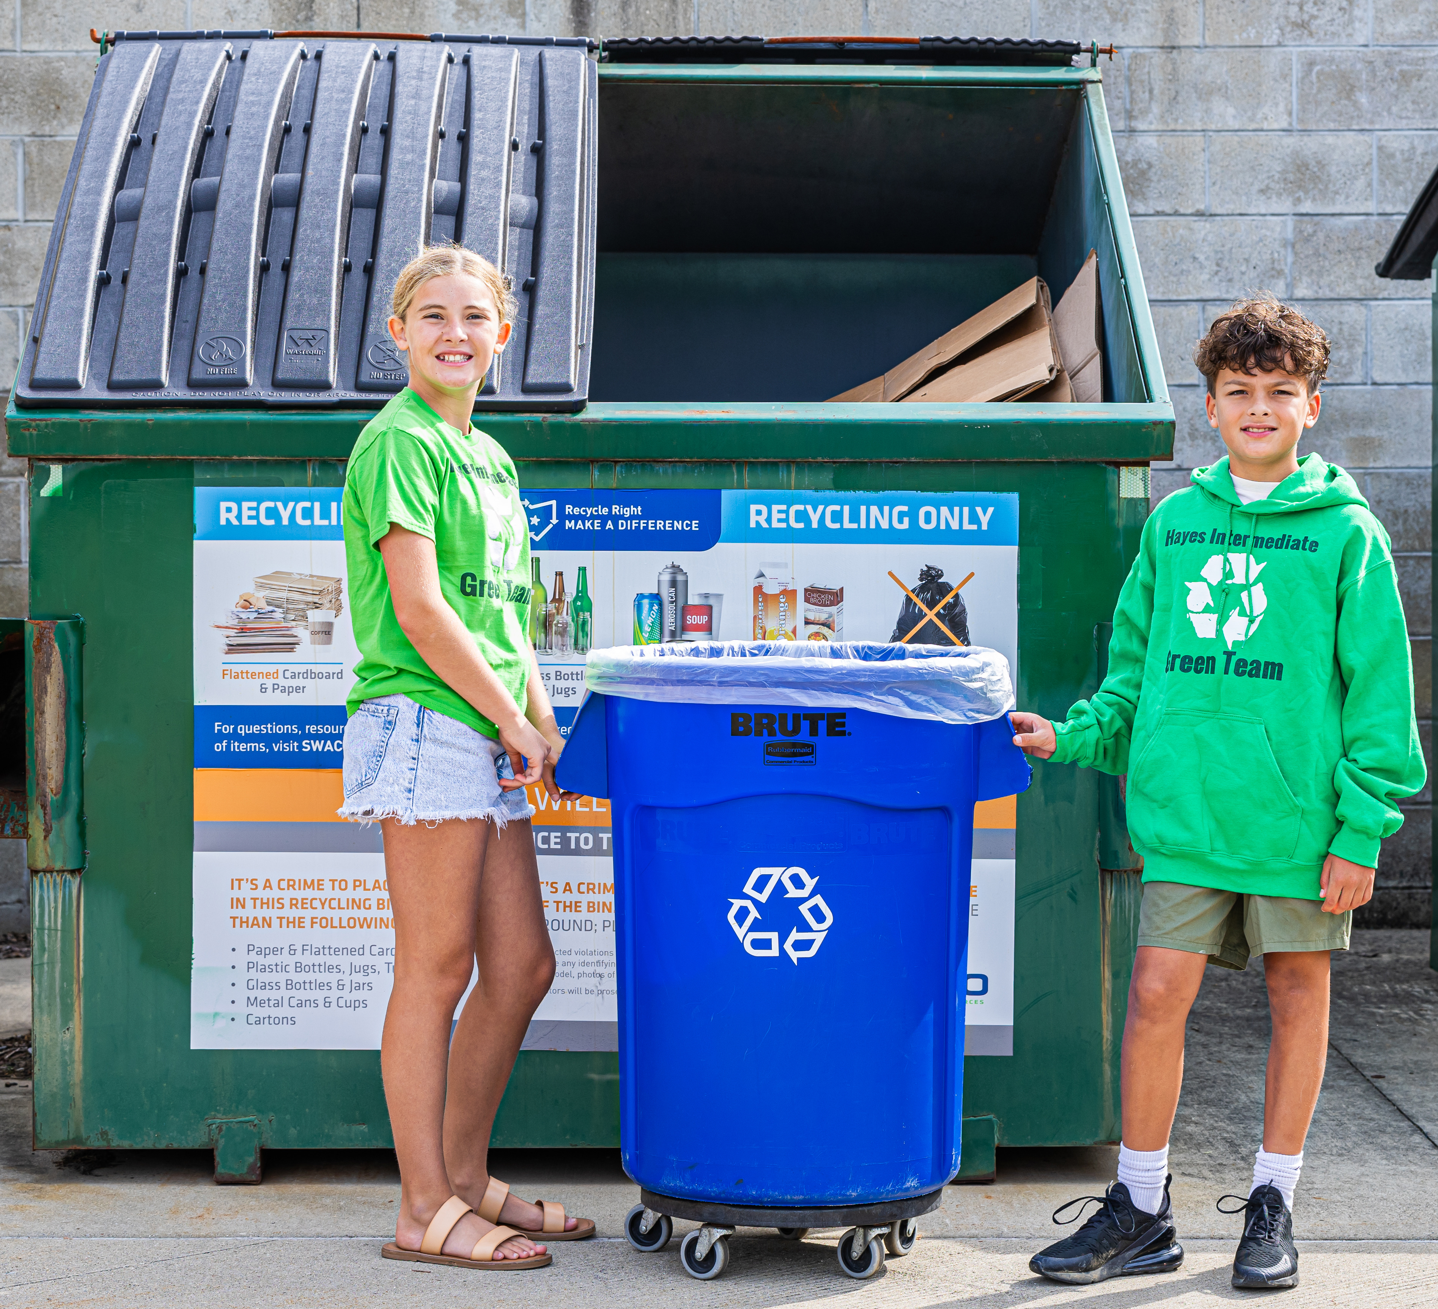

Students Can Be the Difference!
Email schools@swaco.org with questions Or visit https://www.swaco.org/ or https://recycleright.org/ for more resources

Slide 19
Teacher Notes
Side 2 | Ask students these questions. Gather background knowledge.
3 | When you recycle plastic bottles and containers, they can be shredded into plastic pellets and turned back into a new plastic bottle.
4 | Ask students, “Where have your seen this symbol before?” Have students share out responses. (recycling bins, curbside bins, plastic bottles, cardboard boxes, Amazon packages, pop bottles, notebooks, food containers).
5 | Ask: what types of things can be recycled? See if they can name specific items or types of materials before revealing the answers. Note: what is accepted in YOUR school recycling depends on who picks it up and where they take it to. If the hauler takes it to RUMPKE, all of these items are accepted.
6 | After you are finished with your paper, what do you do with it? Have students share out (use it as scrap, recycle it, trash it…) Say: “Paper is recyclable, so hopefully you put it in the recycling bin at school or home. Where does it go after that?”
7 | It is taken outside to a recycling dumpster onsite 1. picked up by a recycling truck 2. taken to a MRF (pronounced Merf – Materials Recovery Facility). MRFs take the materials and use machines or people to sort them by their material types 3. the materials get bailed and sold to a recycling company 4. The paper gets sent to a paper mill where it is made into pulp then pressed back into paper 5. Finally, it can be made into special shapes, sizes, and colors of paper and sold 6. So students like you get to write more amazing stories, poems, solve math problems, plan out inventions, and more.
8 | It goes to the landfill, where it cannot be reused or recycled….ever!!!
9 | When you throw things away in your trash at home or school, it all comes to the Franklin County Sanitary Landfill in Grove City. It is owned and operated by SWACO (Solid Waste Authority of Central Ohio). The natural resources it took (trees) to make the paper is no longer able to be used.

Slide 20
Teacher Notes
Side 10 | Imagine 1,000 elephants marching into the landfill every day. That’s how much trash is dumped each day in just OUR landfill in Franklin County. Imagine how much more is dumped in other landfills in Ohio daily. The total is 10,000,000 pounds a day.
11 | Here is a chart that shows us the types of materials that are being thrown away at our landfill. What do you notice? Take a few minutes to discuss this chart with your class. 76% (more than half) of the items that come to the landfill in Franklin County, COULD be recycled. That’s 3 out of every 4 materials could be recycled. Only 24% or 1 out of 4 materials is what we consider to be truly trash (cannot be recycled). You may even be surprised to see that food waste and cardboard are the top two contributors by percentage. Food waste makes up about 15% and cardboard is 10% of the total waste stream. WE have an amazing opportunity to increase recovery of these materials through increased access and education.
12 | This is why it is so important to reduce, reuse, and recycle. There are many other benefits to recycling other than just keeping our landfill from filling up too quickly.
13 | Let’s watch a short video to find out what happens after recyclables are picked up and hauled away. Click here if the video doesn’t work.
14 | Call on students to call out or circle items that can be recycled at school. Answers: Paper, cardboard, tubs, cups, cartons (made from paper, plastic or aluminum), cans. Greasy pizza boxes are accepted now! Grass clippings and twigs can be composted or put in yard waste collection. Food scraps can be composted or thrown in the trash if composting at school is not available. Plastic bags should be collected and taken back to the store. Plastic silverware goes in the trash. Certain types are compostable. Paper towels are trash or compostable. Answers on next slide.

