Slide 1


Recycling in Schools
Staff Can Be the Difference

Slide 2
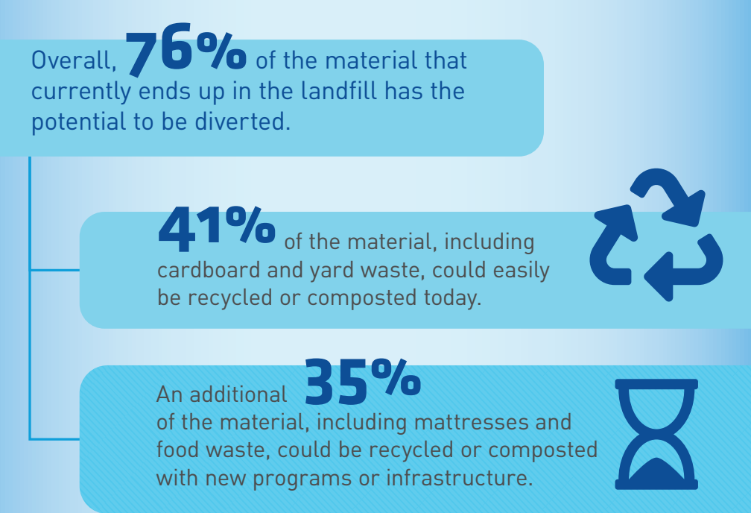
Did you know?

Slide 3
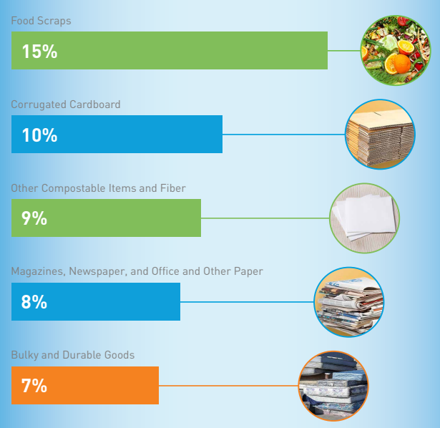
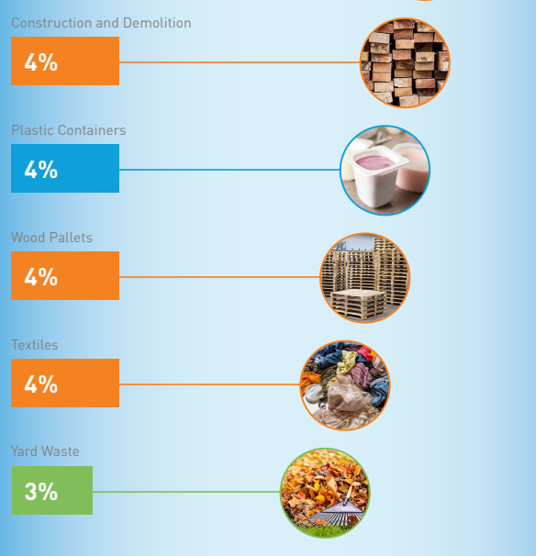
The Top Materials Thrown Away in Ohio
10

Slide 4
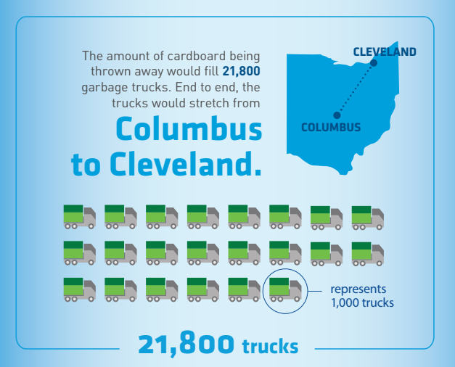
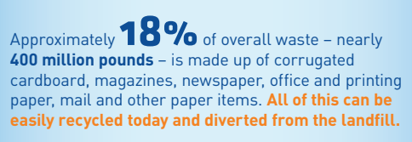

Slide 5
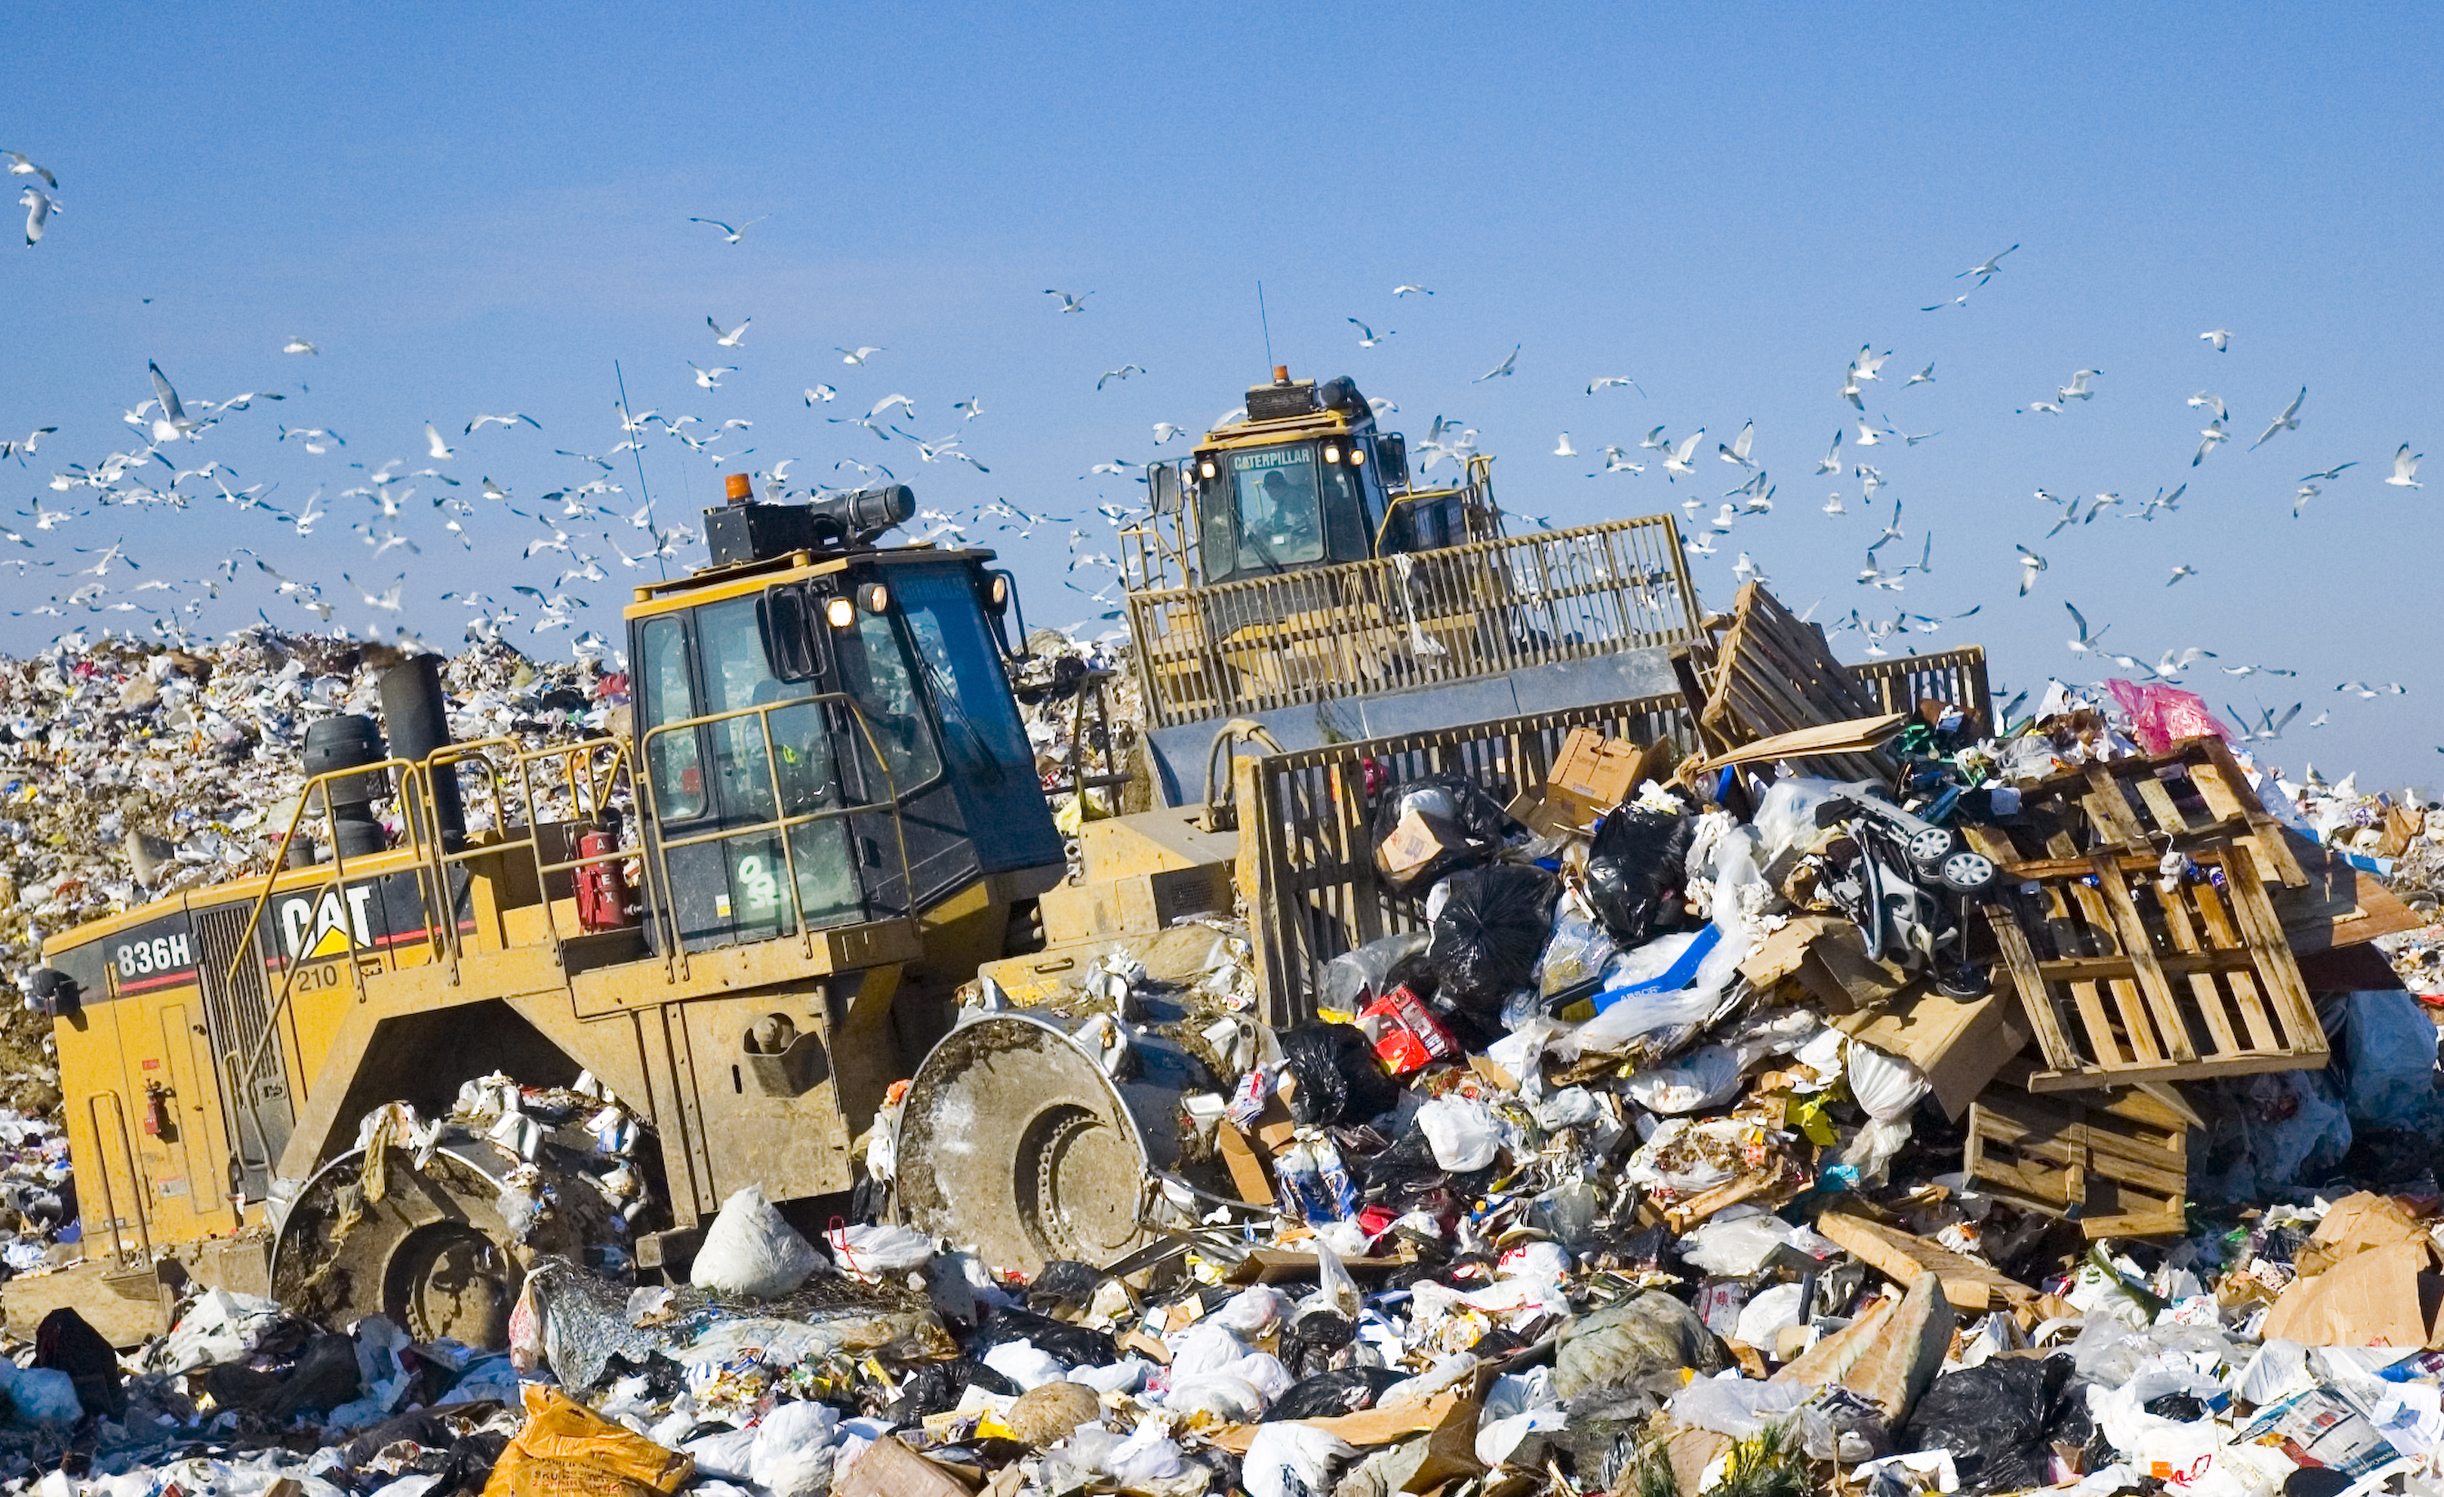
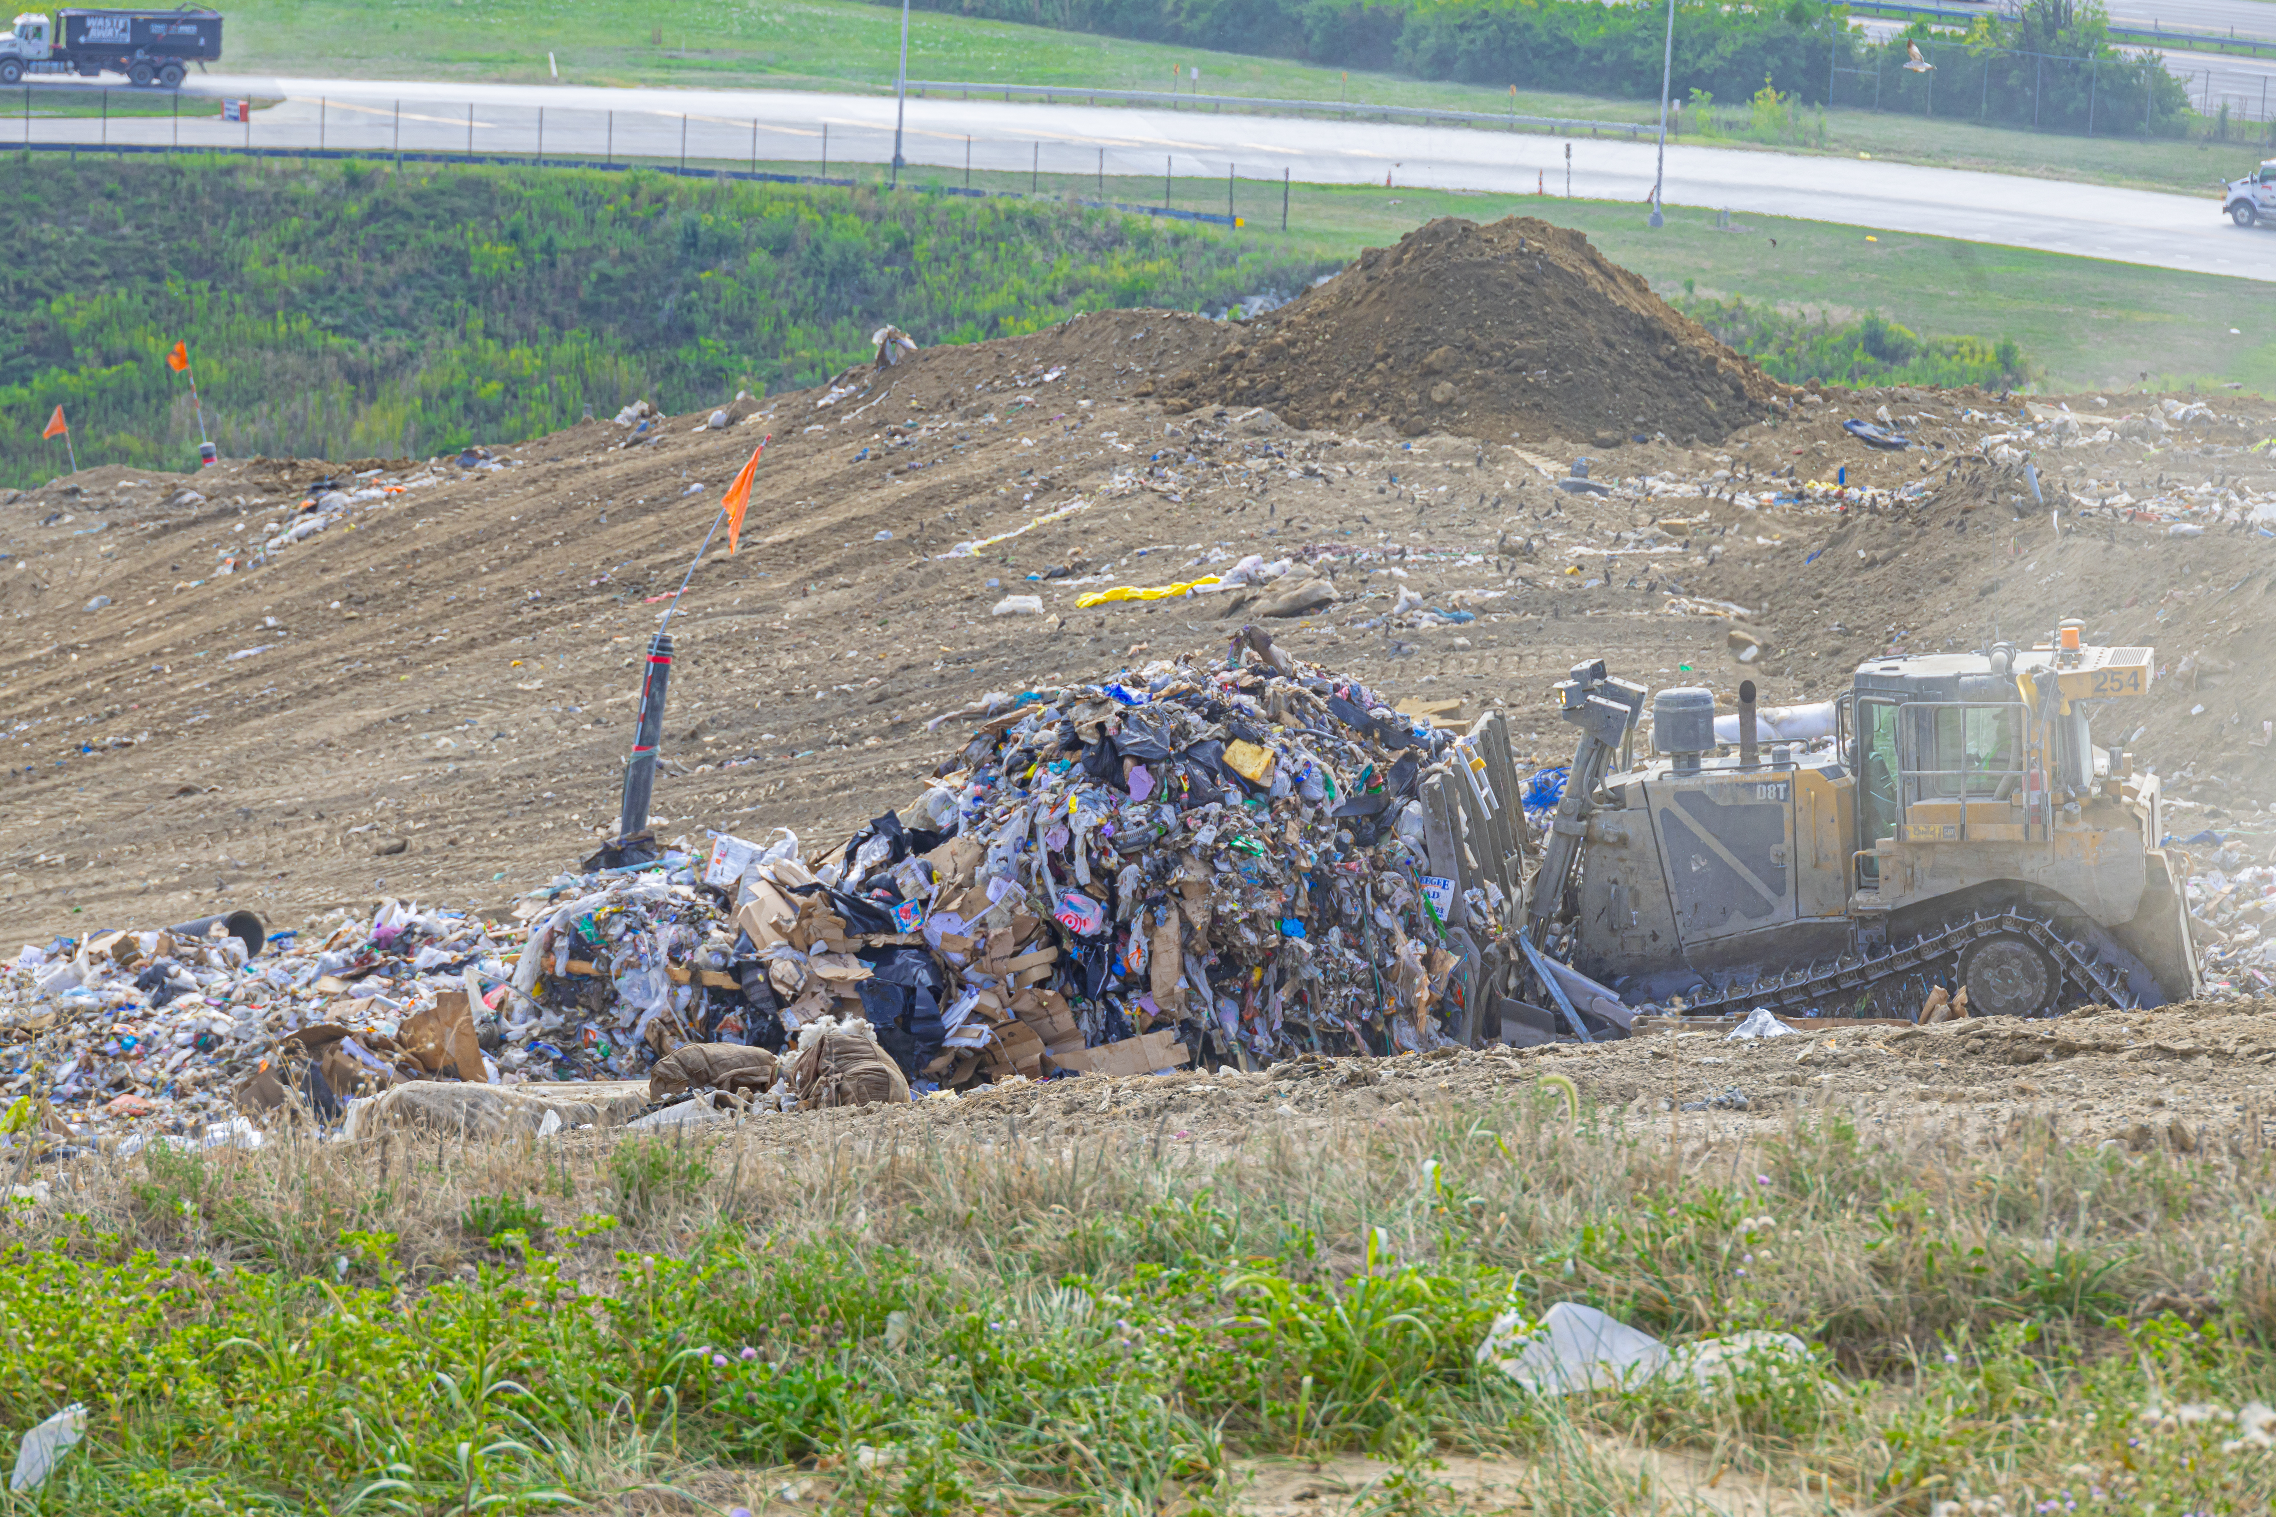
Where does the trash go?
Franklin County Sanitary Landfill
3851 London Groveport Road
Grove City, OH 43123

Slide 6


How Much Trash Comes to the Landfill Daily?
X 1,000
5,000
tons per day of
wasted
materials
X 3,300
Notes:
*In Franklin Co alone, about 4,000 tons of material is landfilled a day. 1.1 million tons in 2017. Since it’s hard to think in terms of tonnage, this is the equivalent to about 800 elephants/day (10,000 lbs each).
Another way to think about this is the landfill has 600-700 trucks a day dumping materials generated by biz and residents in our Country.
Notice I didn’t say garbage or trash landfilled, because what is landfilled are valuable materials, we are just ignoring the value.

Slide 7

Benefits of Recycling

Slide 8

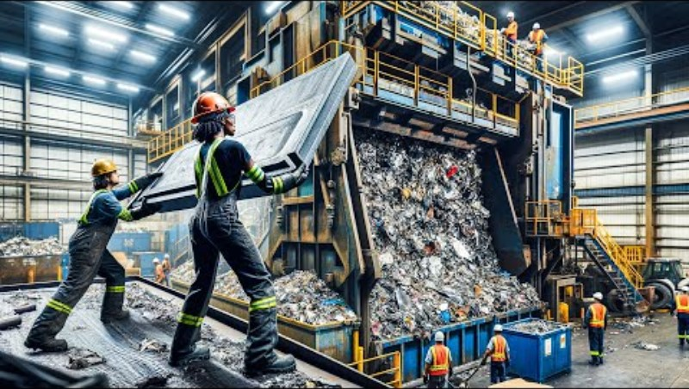
Where Does the Recycling Go?
Watch one or both videos
Click here to view this video.
Click here to view this video.
Notes:
Start at 1:08 and end at 3:52

Slide 9

Be a School Recycling Champion
A successful school recycling program is the result of a team effort by administrators, teachers, custodial staff, & students.
Notes:
These are just ideas for graphics. Do we have some that could represent each stakeholder mentioned in the text above that would be better?

Slide 10
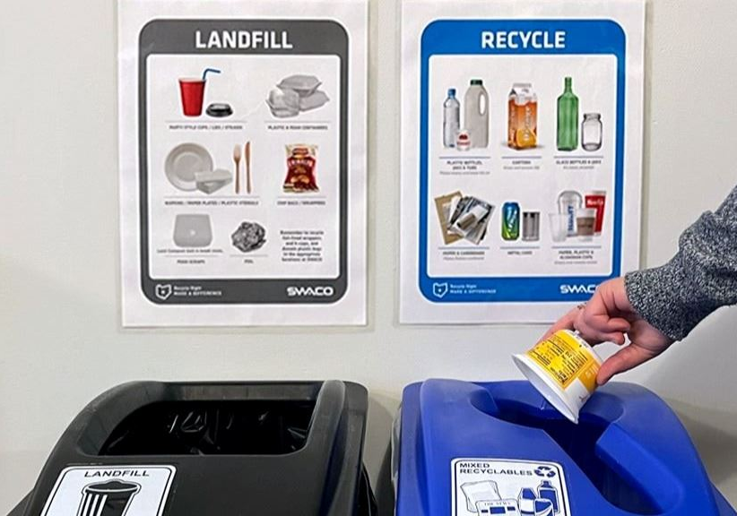
Best Practices
KNOW WHAT YOUR HAULER ACCEPTS Make sure your dumpster has proper signage that matches what is accepted.
LABEL ALL BINS
Laminate labels and place them at eye- level.
TWIN THE BIN
Always pair a blue recycling bin with a black landfill bin.
This will ensure your recycling stream does not become contaminated with materials that are not accepted for recycling at your school.
USE DIFFERENT BAGS
Use black bags for landfill and clear bags for recycling.
This helps to quickly identify what types of materials are in the bag.

Slide 11
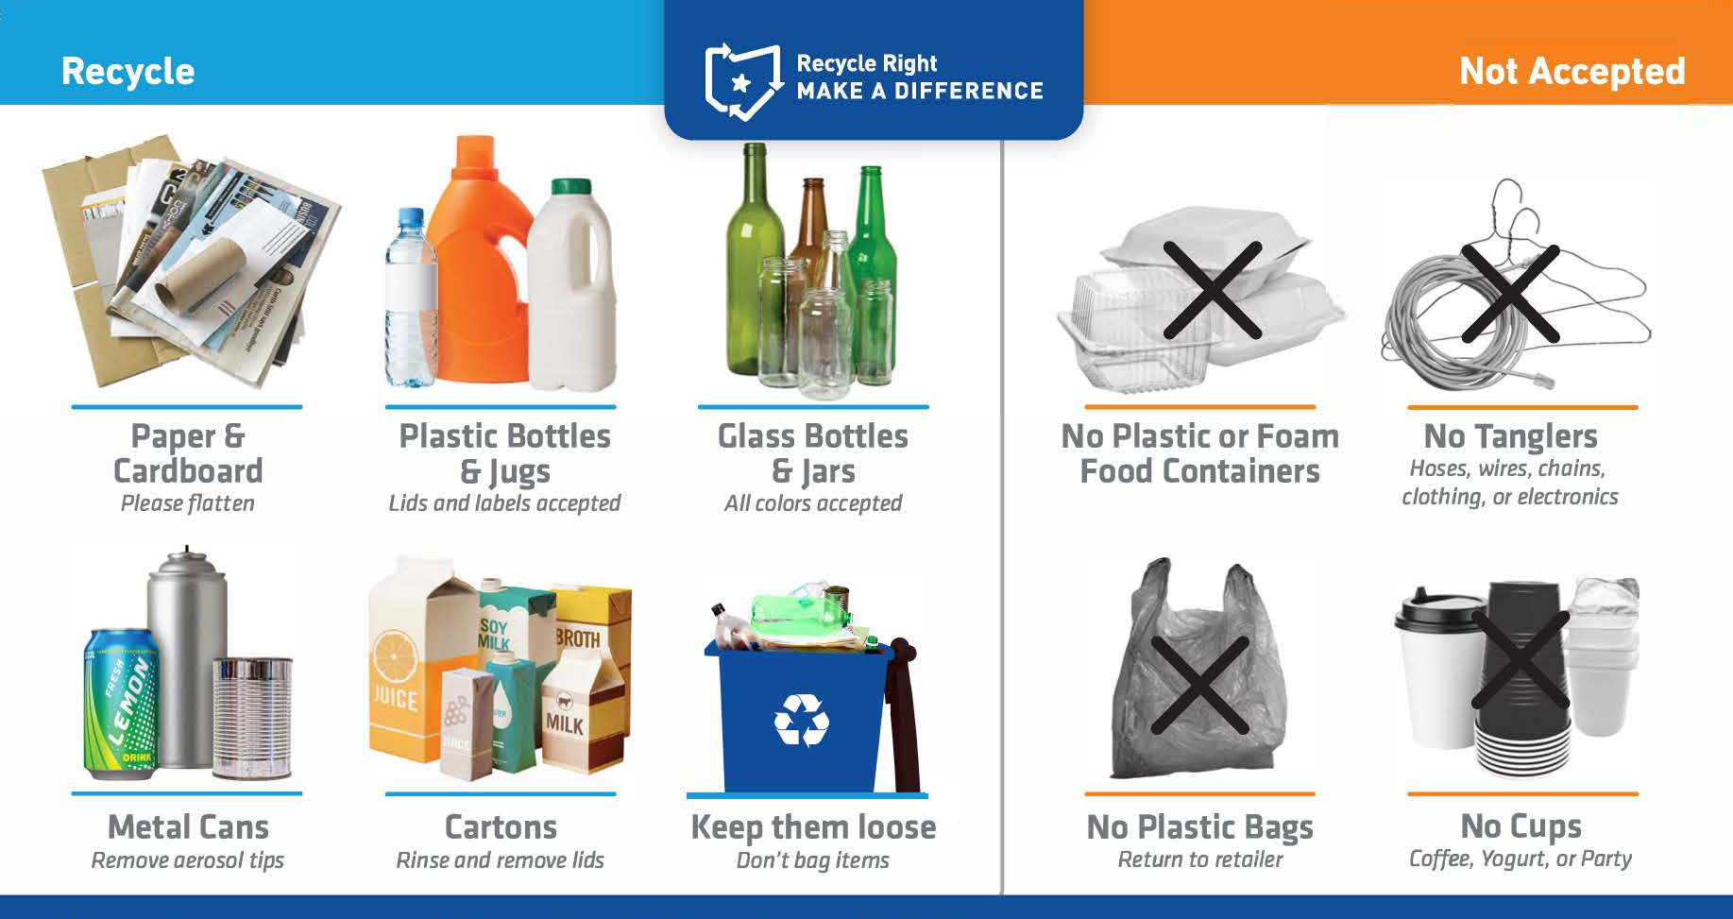
Items Typically Accepted for Recycling
Accepted items vary depending on your hauler. Be sure to know what your hauler accepts. You can check the signage on the outside bin.
If using liners, do not tie them. Empty them and reuse them or leave them loose.
Notes:
So, how can you get involved.
Know what’s accepted for recycling and practice this at home and work.
Does any of this surprise anyone? Do you have questions about things you’re currently recycling that aren’t accepted?
What about those starbucks and other carry out coffee cups? Are you recycling them?

Slide 12
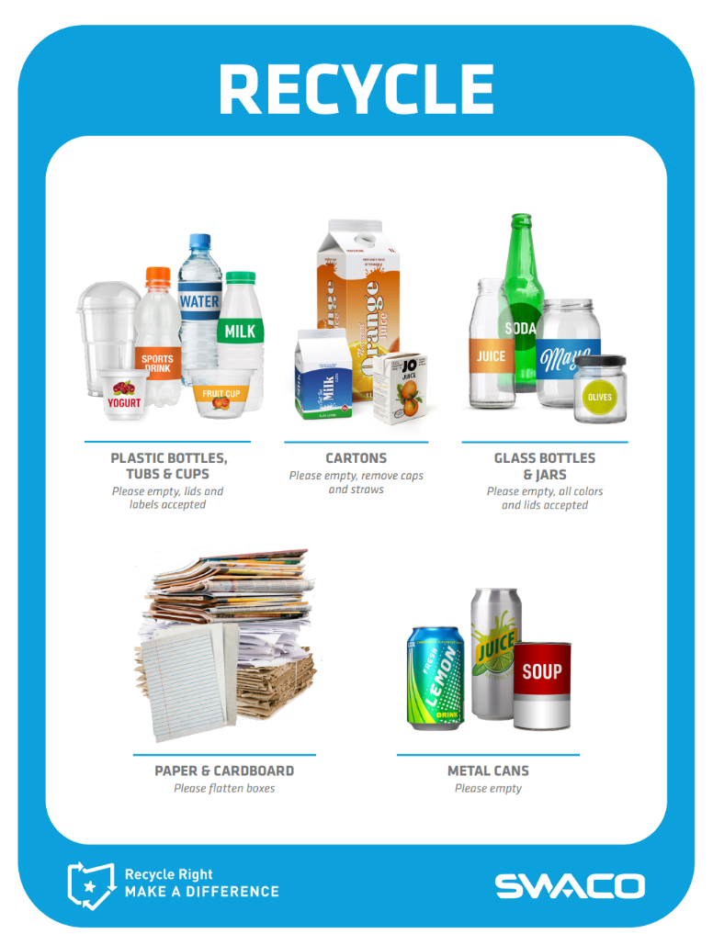
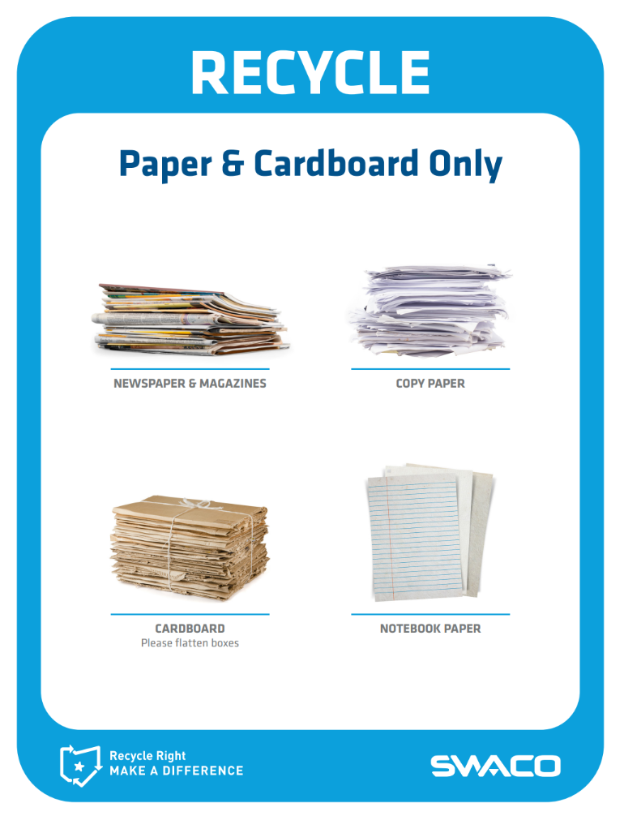
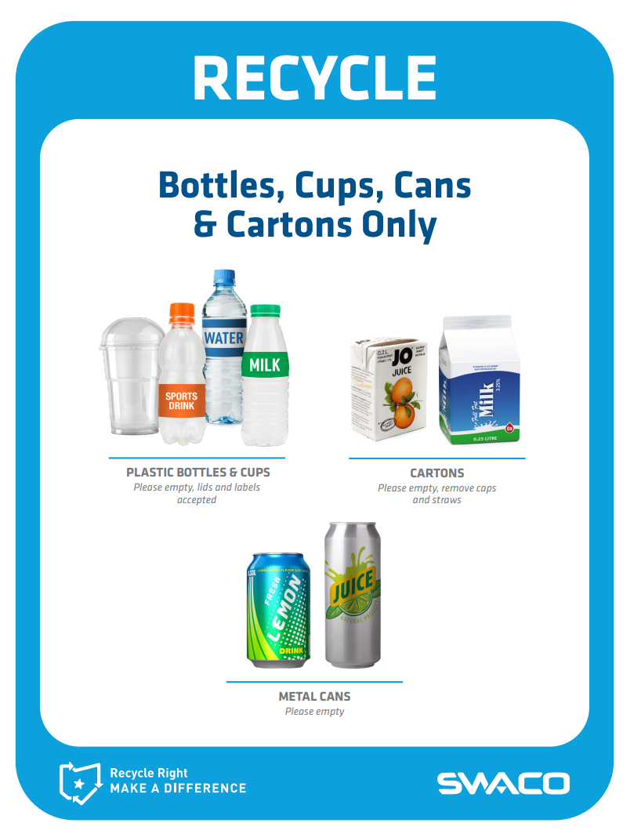
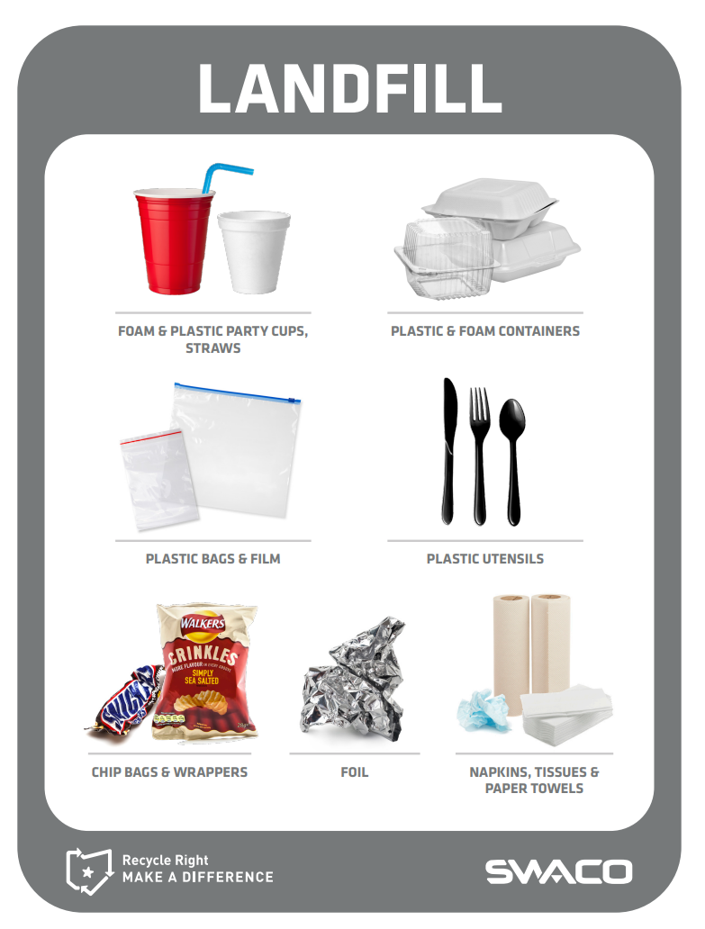
Print Your Signs and Place at Eye-Level
Visit swaco.org to print your signs!

Slide 13
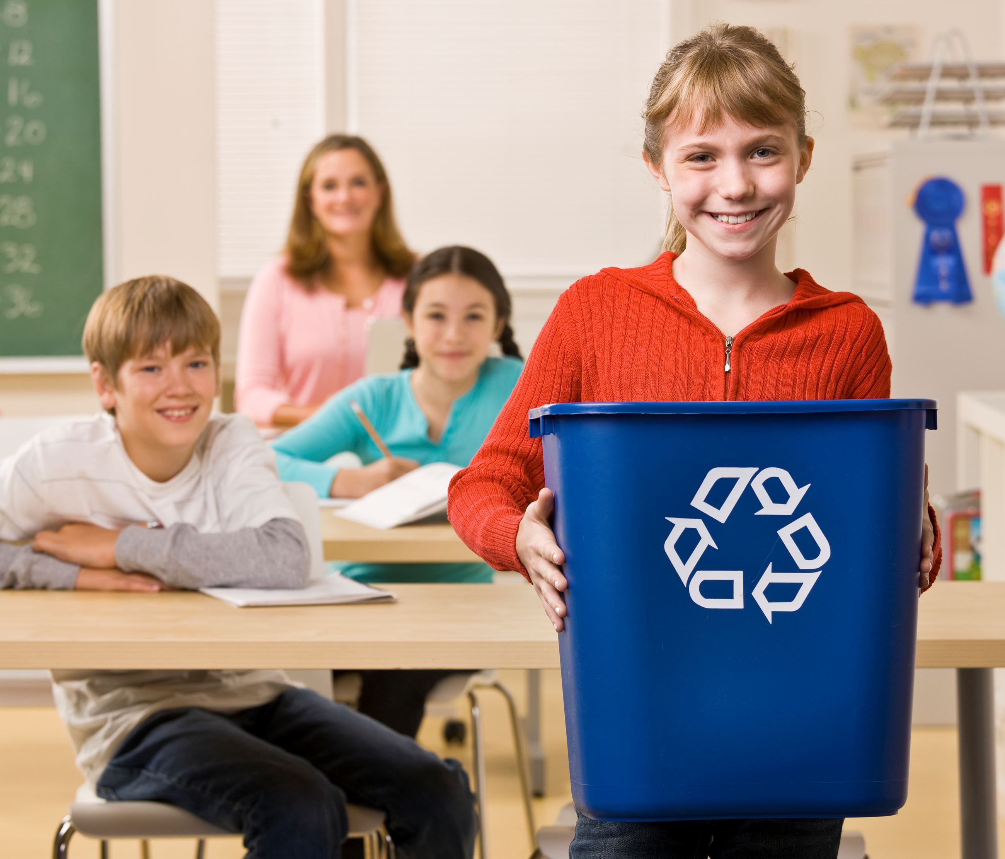
Tips and Resources to Make Recycling Easier for You
Involve students in helping. Remember, it’s a team effort.
You could do paper and cardboard only in classroom bins to lessen the chance for contamination.
Utilize our student slide presentation so all students can recycle successfully.
Check out our Teacher Lesson Plans and Student Activities.
Let students play free online games.
Notes:
Danna will add food waste tips down the road when we implement that program more in schools.

Slide 14
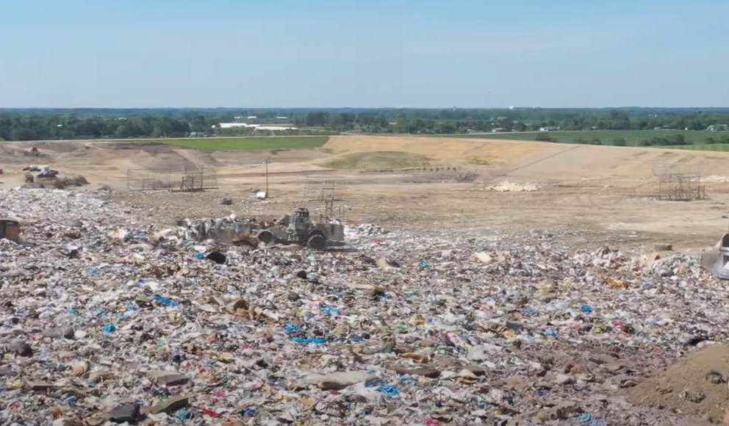

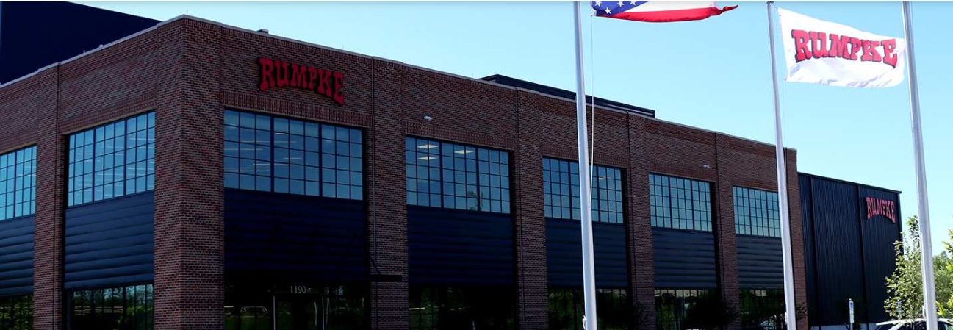
Did you know adults can schedule a tour too?
Check out our landfill tours and programs
Take The Recycle Right Quiz
Schedule a Rumpke Recycling Center Tour

Slide 15

Staff Can Be the Difference!
Email schools@swaco.org with questions Or visit https://www.swaco.org/ or https://recycleright.org/ for more resources

