Slide 1


Recycling in Schools
Students Can Be the Difference

Slide 2
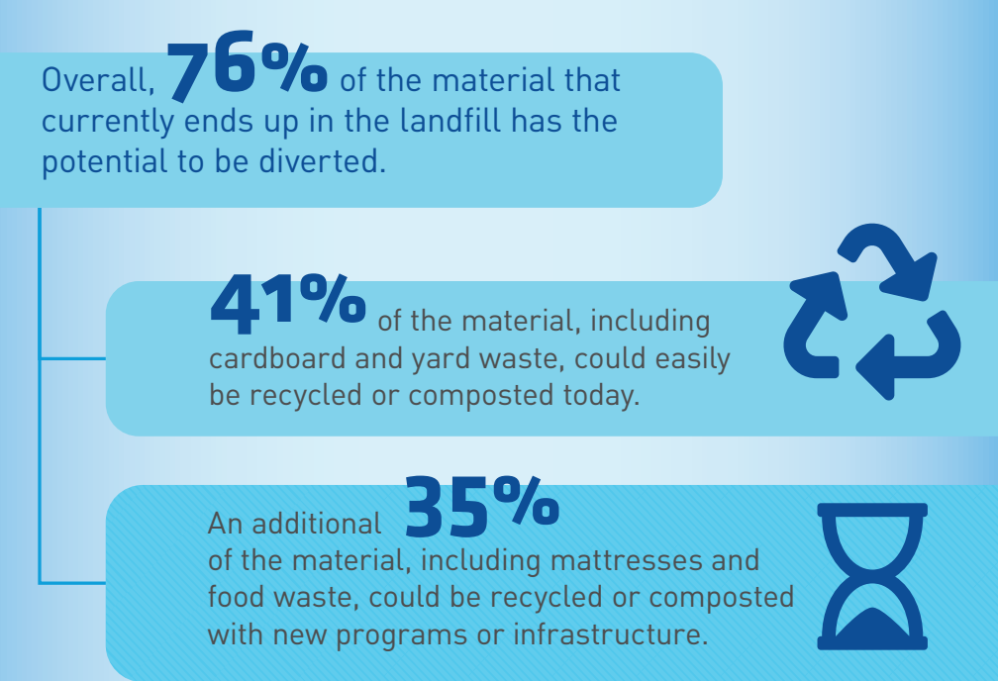
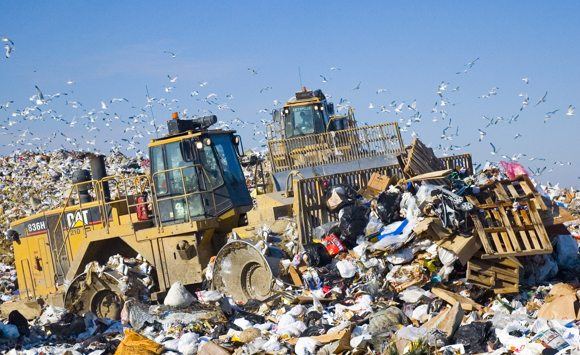
Did you know?

Slide 3
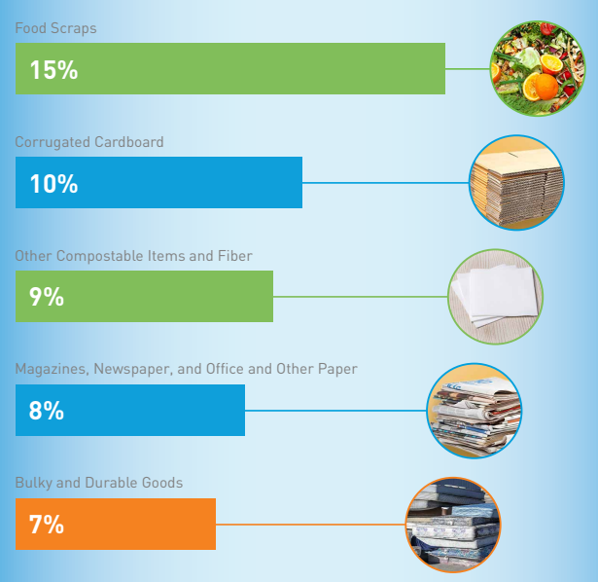
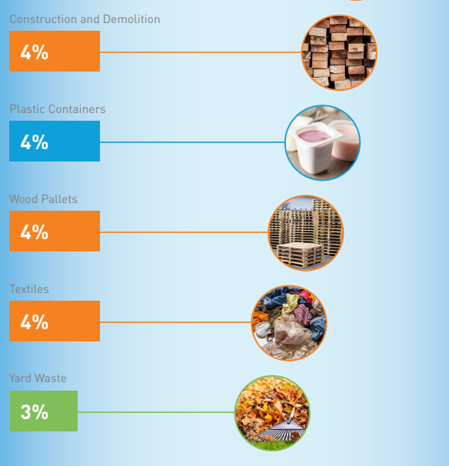
The Top Materials Thrown Away in Ohio
10

Slide 4
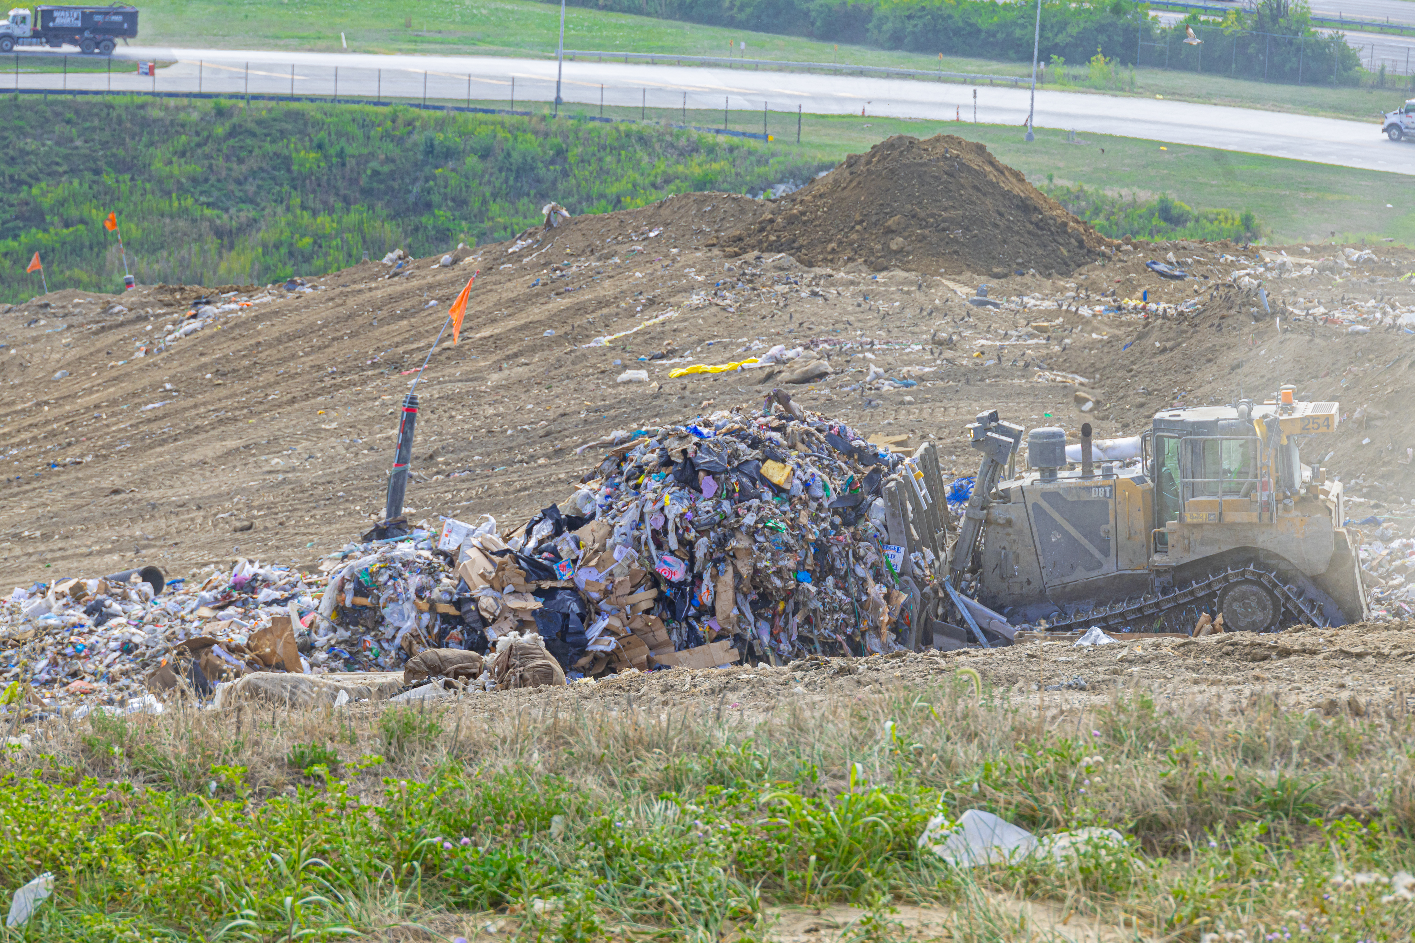
Where does the trash go?
Franklin County Sanitary Landfill
3851 London Groveport Road
Grove City, OH 43123

Slide 5

How Much Trash Comes to the Landfill Daily?
5,000
tons per day of
wasted
materials
That is like 1,000 elephants
Notes:
*In Franklin Co alone, about 4,000 tons of material is landfilled a day. 1.1 million tons in 2017. Since it’s hard to think in terms of tonnage, this is the equivalent to about 800 elephants/day (10,000 lbs each).
Another way to think about this is the landfill has 600-700 trucks a day dumping materials generated by biz and residents in our Country.
Notice I didn’t say garbage or trash landfilled, because what is landfilled are valuable materials, we are just ignoring the value.

Slide 6

Benefits of Recycling

Slide 7

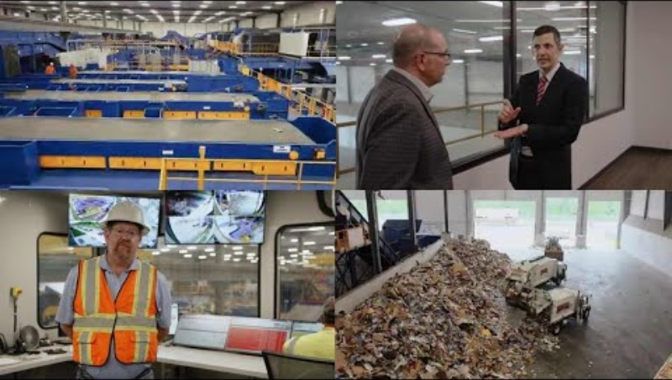
Where Does the Recycling Go?
Click here to watch this short video.
Click here to view this video.

Slide 8

Be a School Recycling Champion
A successful school recycling program is the result of a team effort by administrators, teachers, custodial staff, & students.
Notes:
These are just ideas for graphics. Do we have some that could represent each stakeholder mentioned in the text above that would be better?

Slide 9
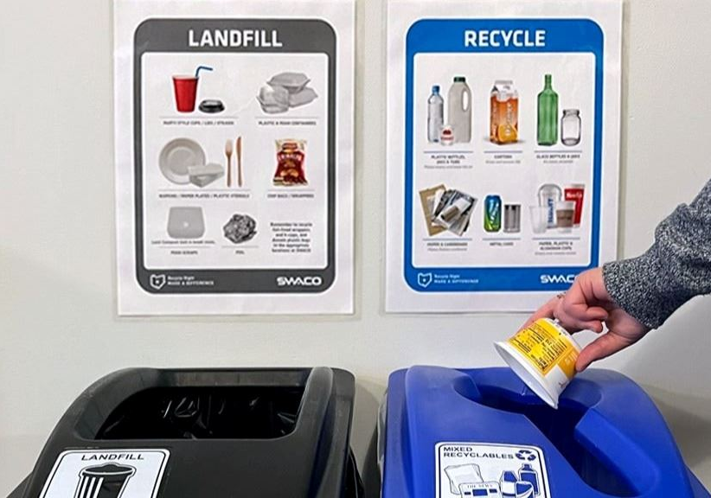
Best Practices
Put your items in the correct bin.
Look at the signs to help you.
DO NOT put liquids in the recycling can.

Slide 10
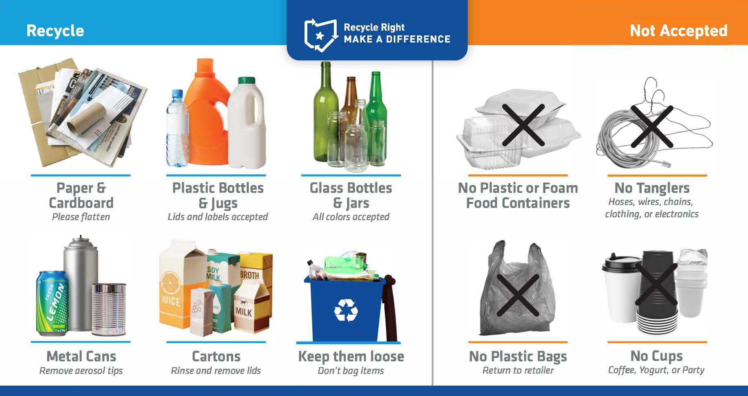
Items Typically Accepted for Recycling
Notes:
So, how can you get involved.
Know what’s accepted for recycling and practice this at home and work.
Does any of this surprise anyone? Do you have questions about things you’re currently recycling that aren’t accepted?
What about those starbucks and other carry out coffee cups? Are you recycling them?

Slide 11
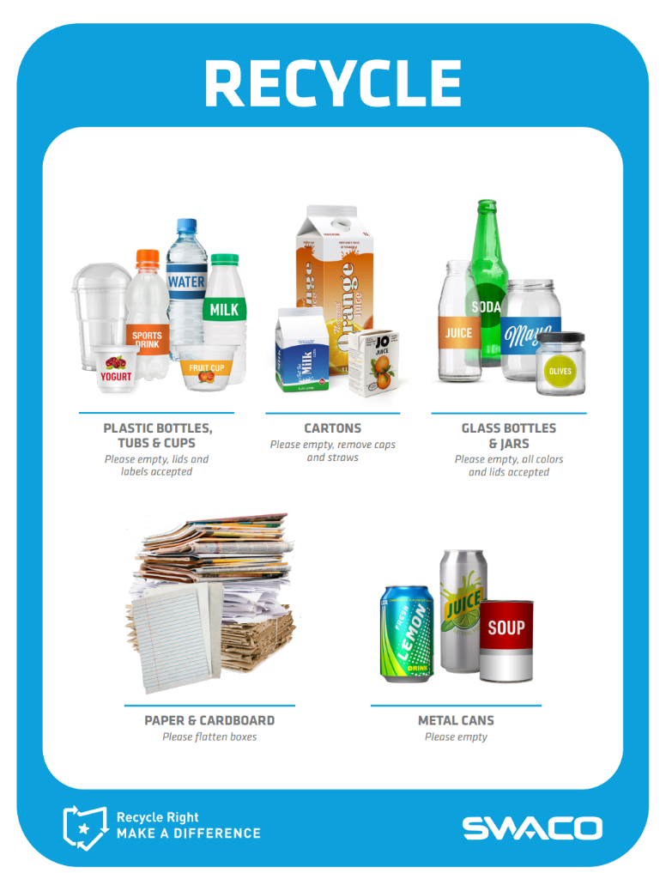
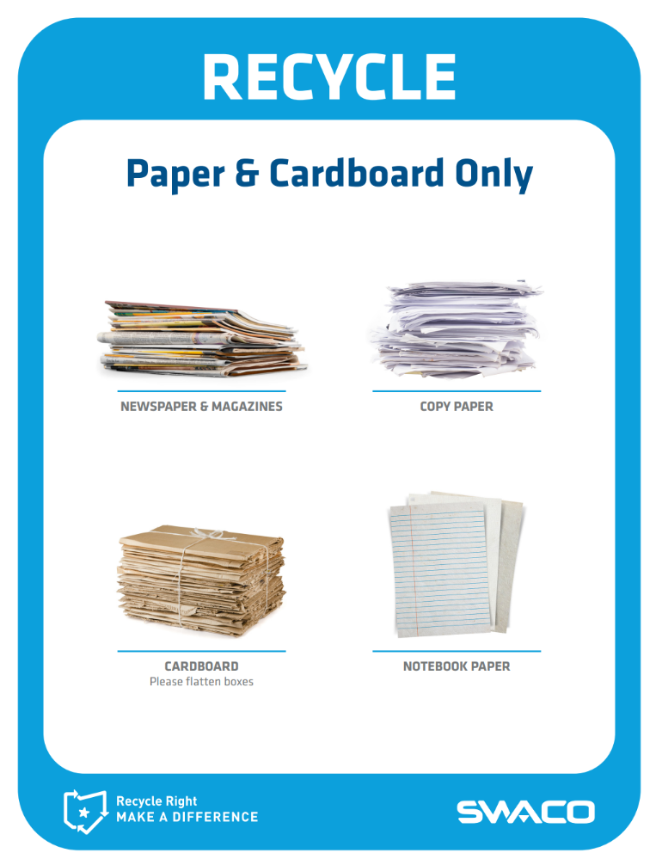

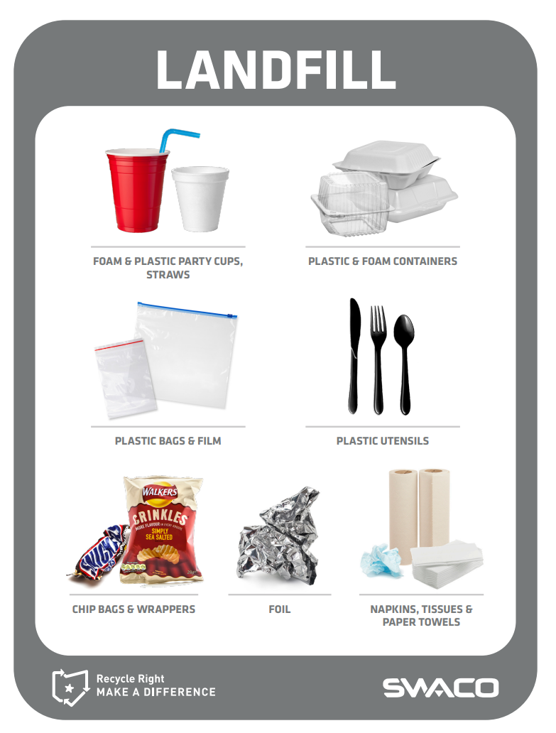
Print Your Signs and Place at Eye-Level
Visit swaco.org to print your signs!

Slide 12
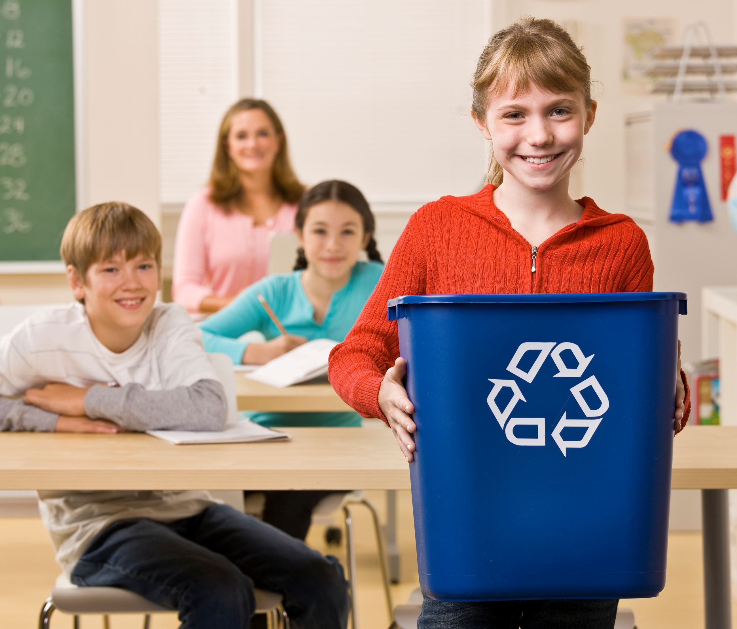
Tips and Resources to Make Recycling Easier for You
Check out our Teacher Lesson Plans and Student Activities.
Let students play free online games.
Notes:
Danna will add food waste tips down the road when we implement that program more in schools.

Slide 13
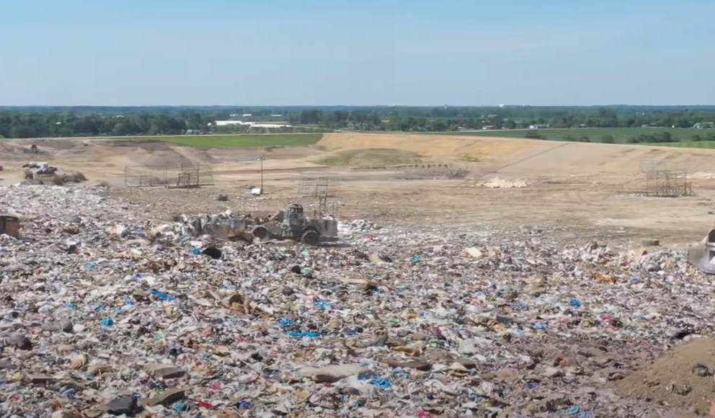

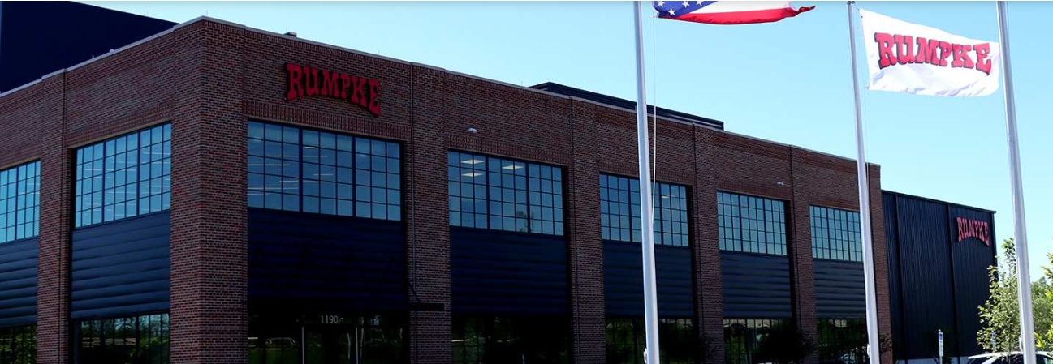
Did you know you can take a free landfill fieldtrip?
Check out our landfill tours and programs
Take The Recycle Right Quiz
Schedule a Rumpke Recycling Center Tour
Rumpke Recycling Center

Slide 14

Students Can Be the Difference!
Email schools@swaco.org with questions Or visit https://www.swaco.org/ or https://recycleright.org/ for more resources

